Slide 1
CFUW in the world
UNCSW60
Presented by
Cheryl Hayles, VP International Relations

Slide 2
“When you realize there is nothing lacking, the whole world belongs to you”.
Taoist proverb

Slide 3
New Beginnings

Slide 4
National Capacity Building
Major groups and other stakeholders have played a significant role in the process to formulate the universal and transformative 2030 Agenda for Sustainable Development and the 17 SDGs that are at its core. Achieving the 2030 Agenda and the SDGs in each country will depend on collaborative partnerships between governments and non-State actors at all levels, and at all stages of the programmatic cycle-planning, consultations, implementation, monitoring and reviews.

Slide 5
TRANSFORMING OUR WORLD: THE 2030 AGENDA FOR SUSTAINABLE DEVELOPMENT
1. NO POVERTY
2. ZERO HUNGER
3. GOOD HEALTH AND WELL-BEING
4. QUALITY EDUCATION
5. GENDER EQUALITY

Slide 6
TRANSFORMING OUR WORLD: THE 2030 AGENDA FOR SUSTAINABLE DEVELOPMENT
6. CLEAN WATER
7. AFFORDABLE AND CLEAN ENERGY
8. DECENT WORK AND ECONOMIC GROWTH
9. INDUSTRY, INNOVATION AND INFRASTRUCTURE
10. REDUCED INEQUALITIES

Slide 7
TRANSFORMING OUR WORLD: THE 2030 AGENDA FOR SUSTAINABLE DEVELOPMENT
11. SUSTAINABLE CITIES AND COMMUNITIES
12. RESPONSIBLE CONSUMPTION AND PRODUCTION
13. CLIMATE ACTION
14. LIFE BELOW WATER
15. LIFE ON LAND

Slide 8
TRANSFORMING OUR WORLD: THE 2030 AGENDA FOR SUSTAINABLE DEVELOPMENT
16. PEACE, JUSTICE AND STONG INSTITUTIONS
17. PARTNERSHIPS FOR THE GOALS

Slide 10
CFUW has ECOSOC status and therefore has the privilege to take 20 delegates to the United Nations Commission on the Status of Women annually. This is an uncommon journey for the brave, courageous, action oriented advocate. One must travel with an extra pair of ears to listen, an additional heart to replace the one that will be broken when you hear some of the stories and a buddy to help you dream the nobel dream that you must pursue when you return home.

Slide 11
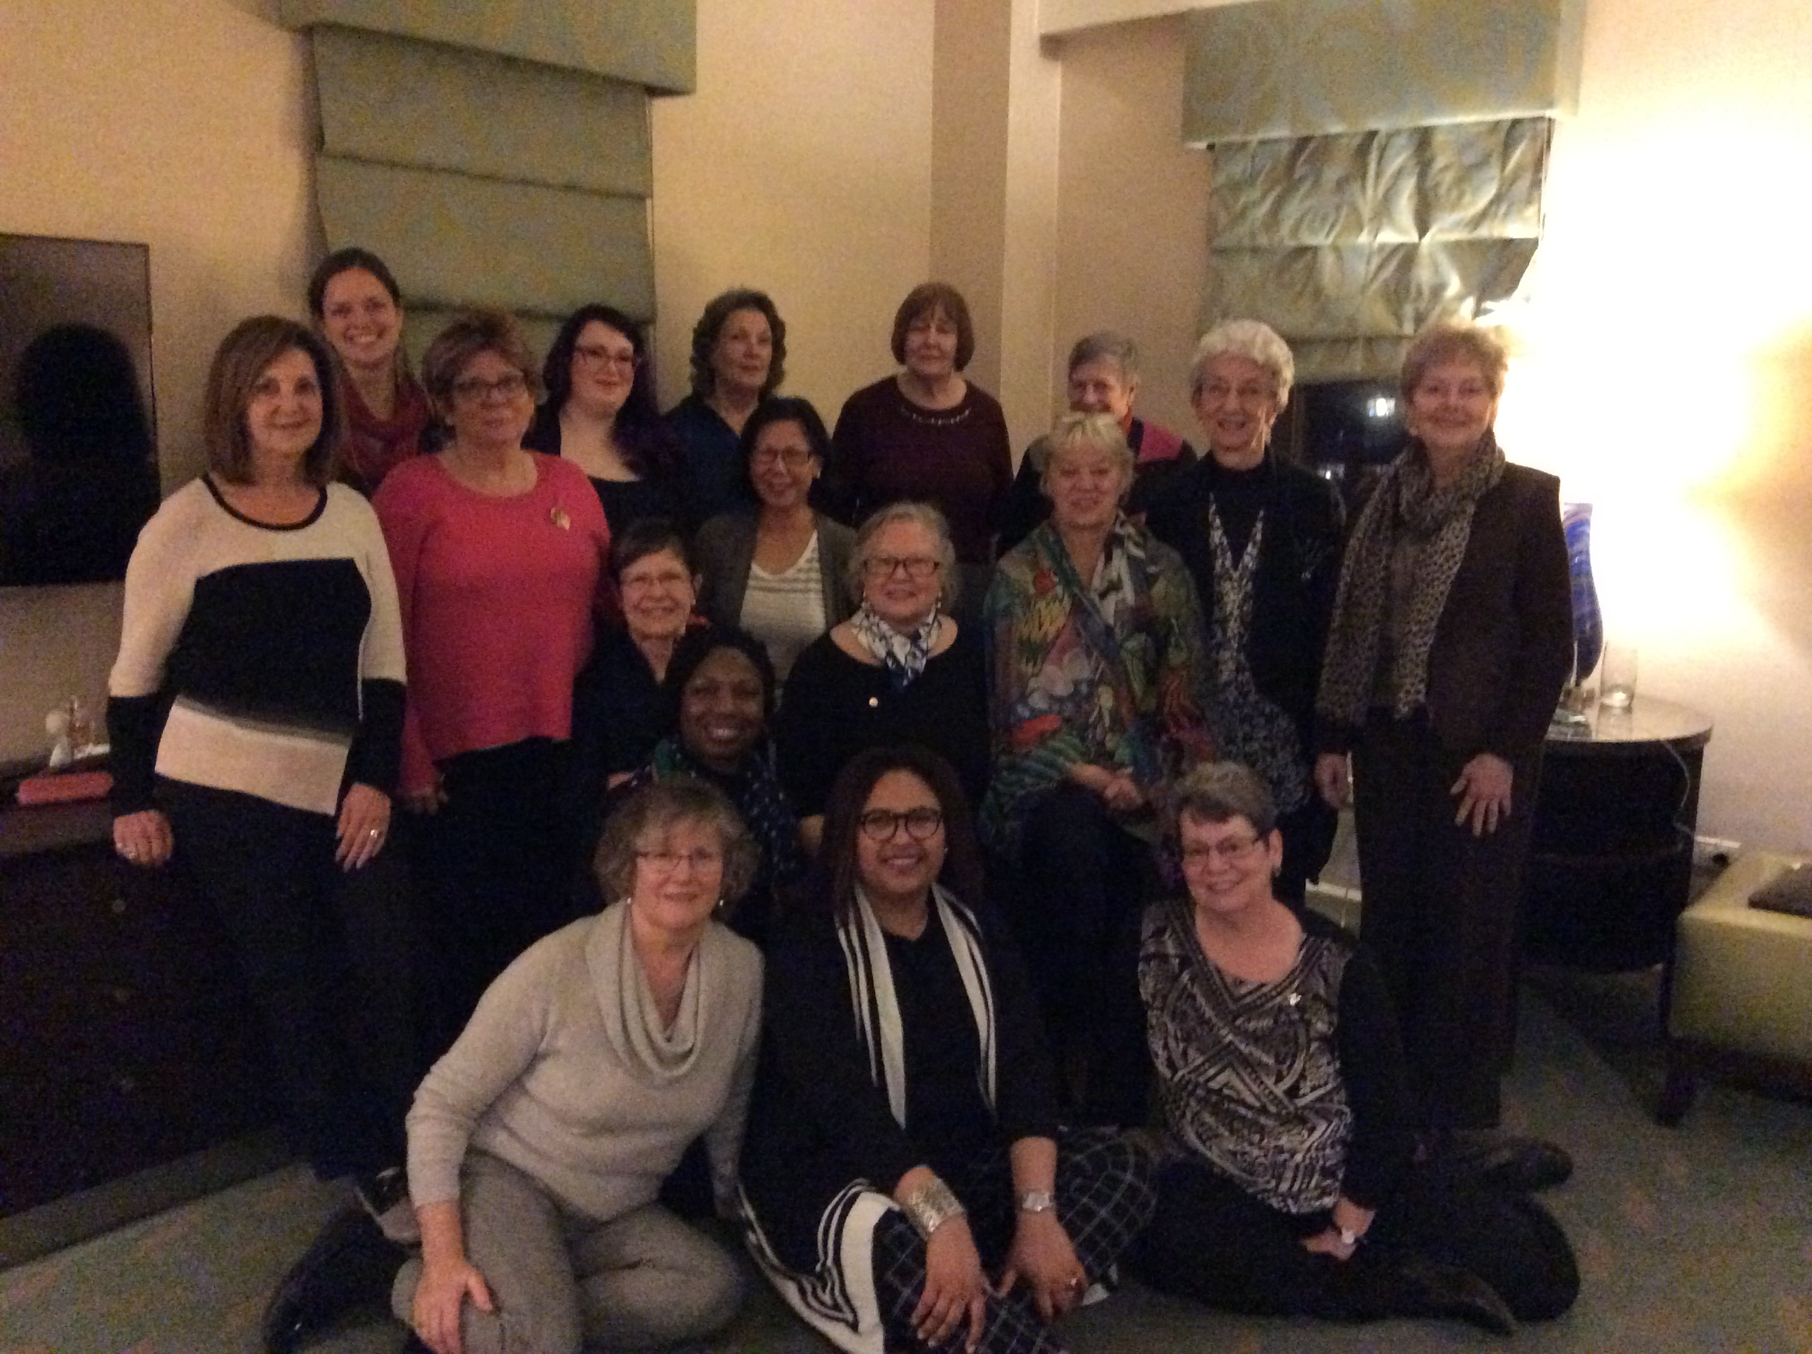

Slide 12
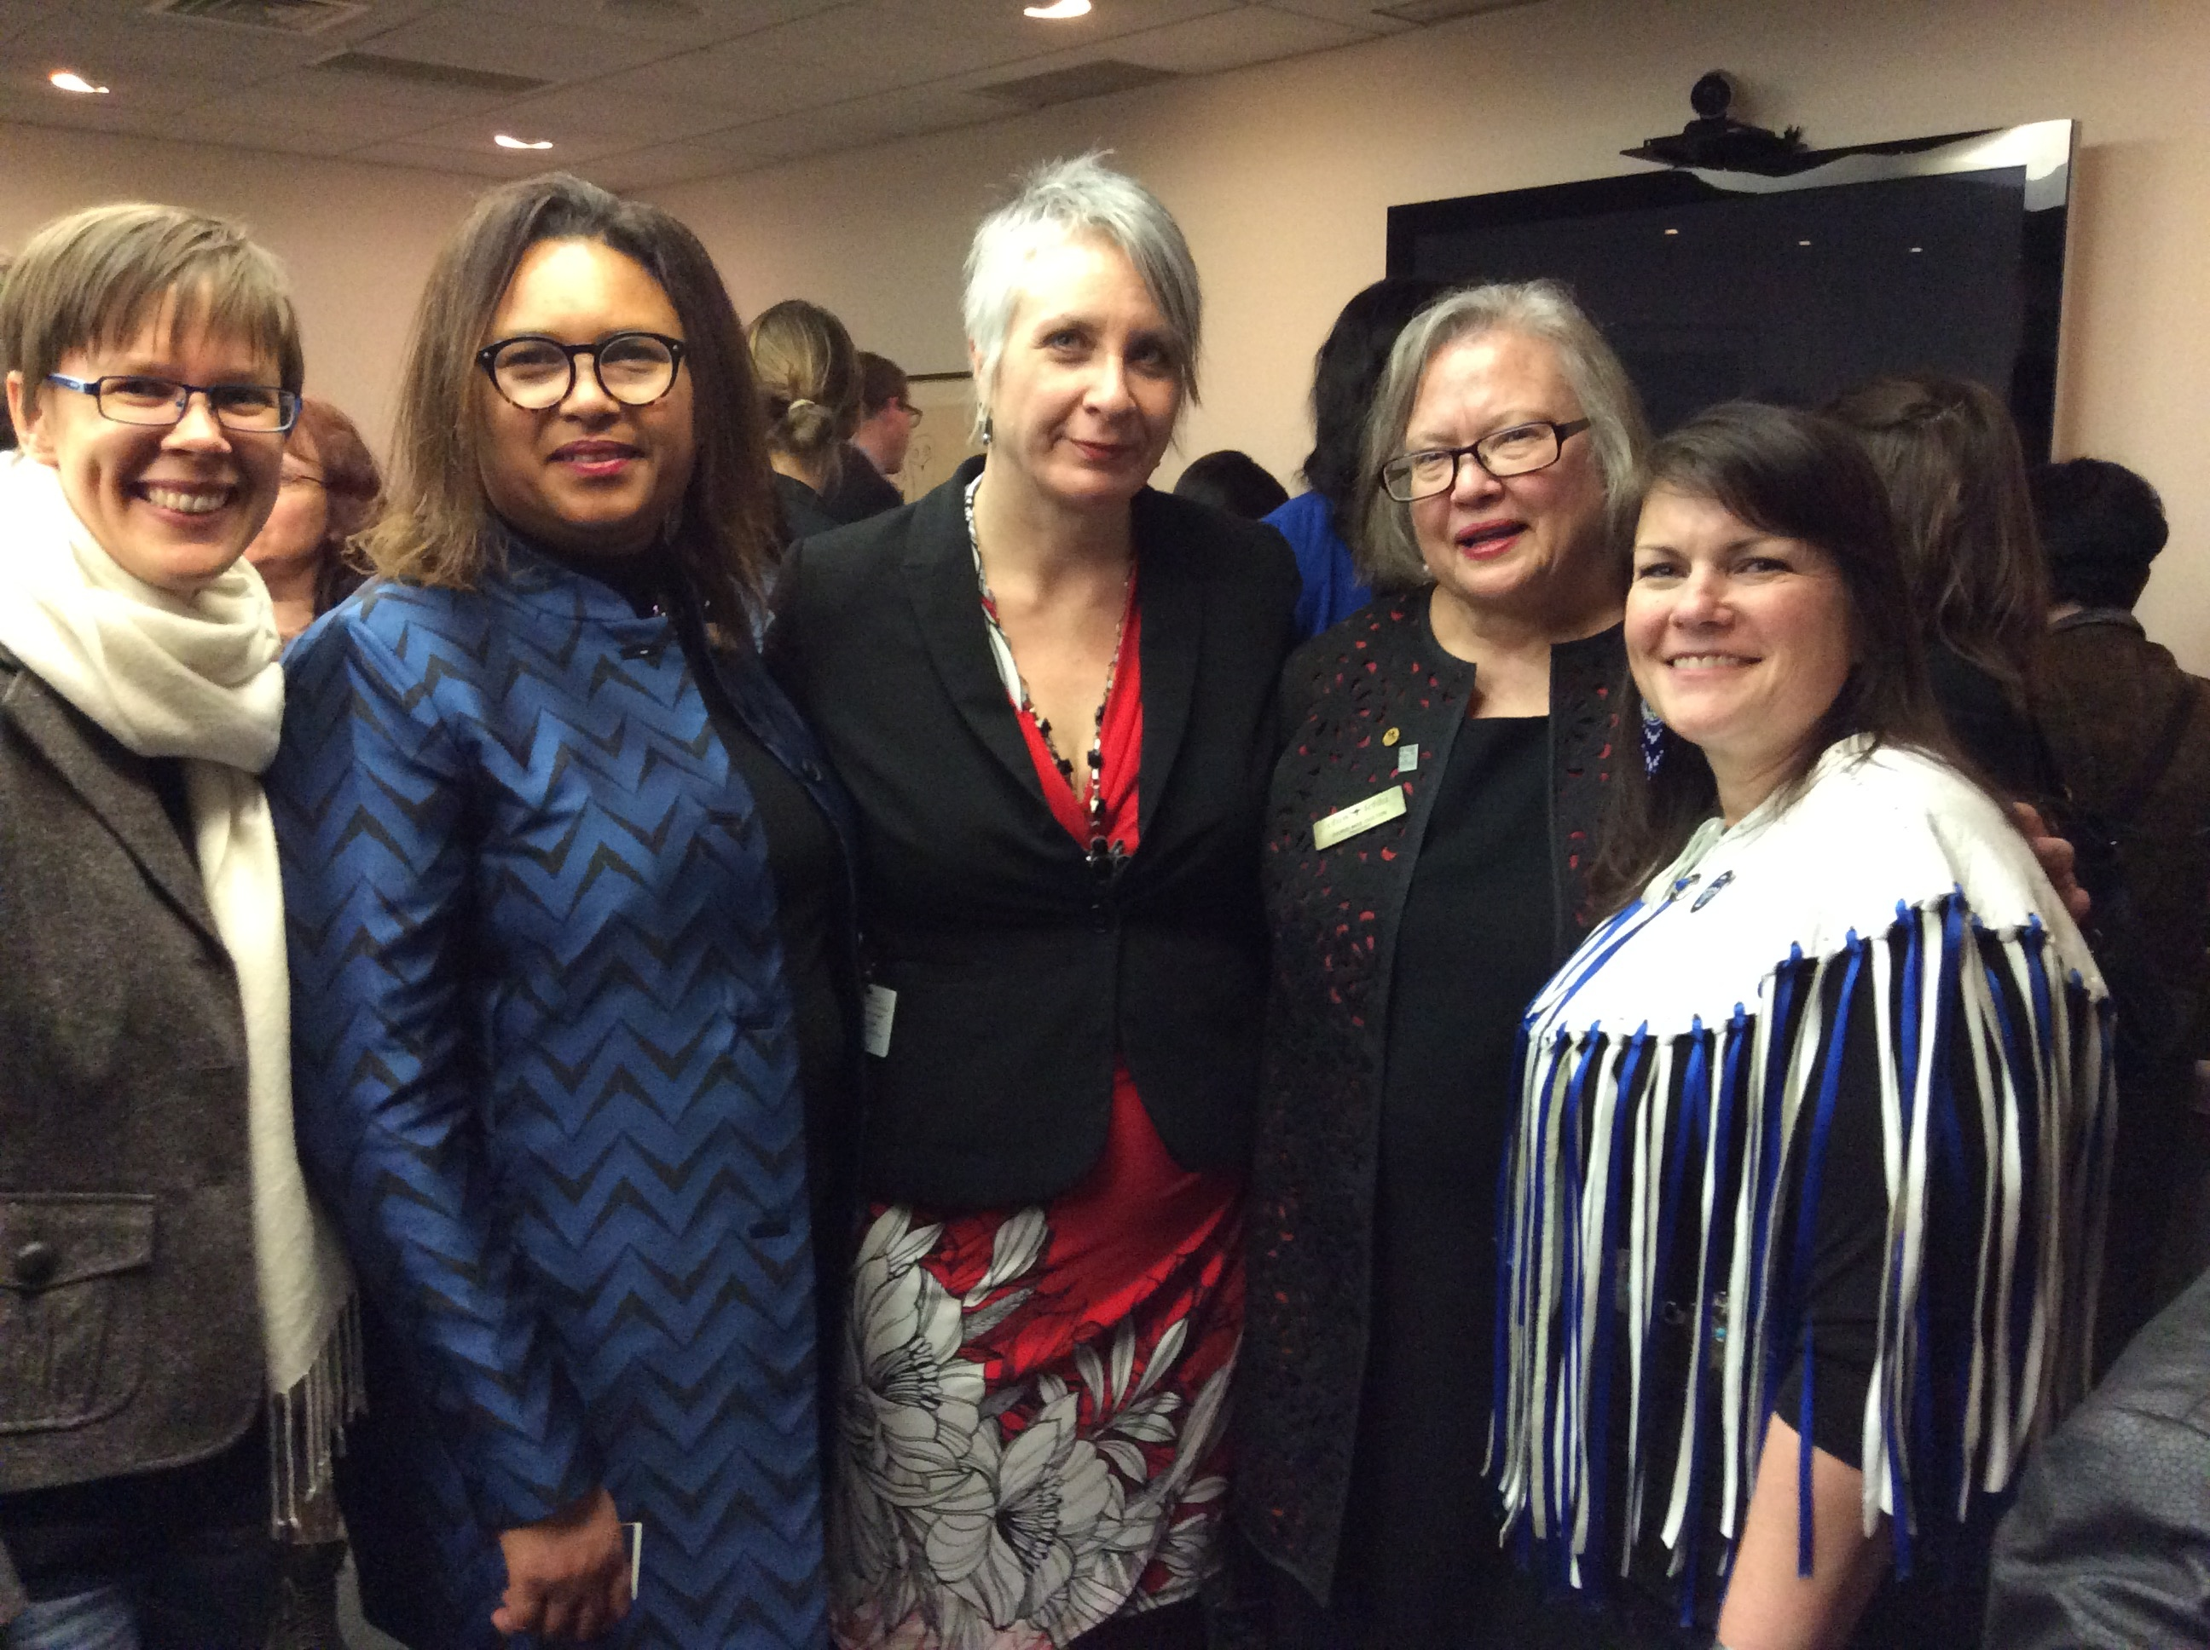

Slide 13
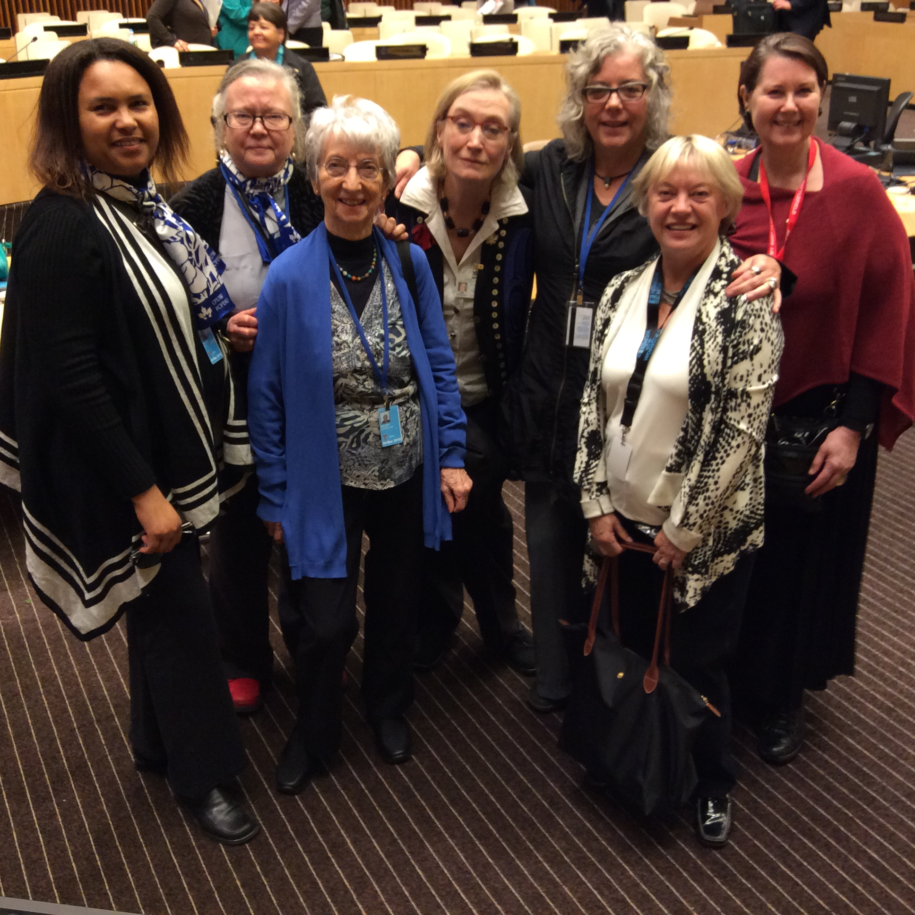

Slide 14
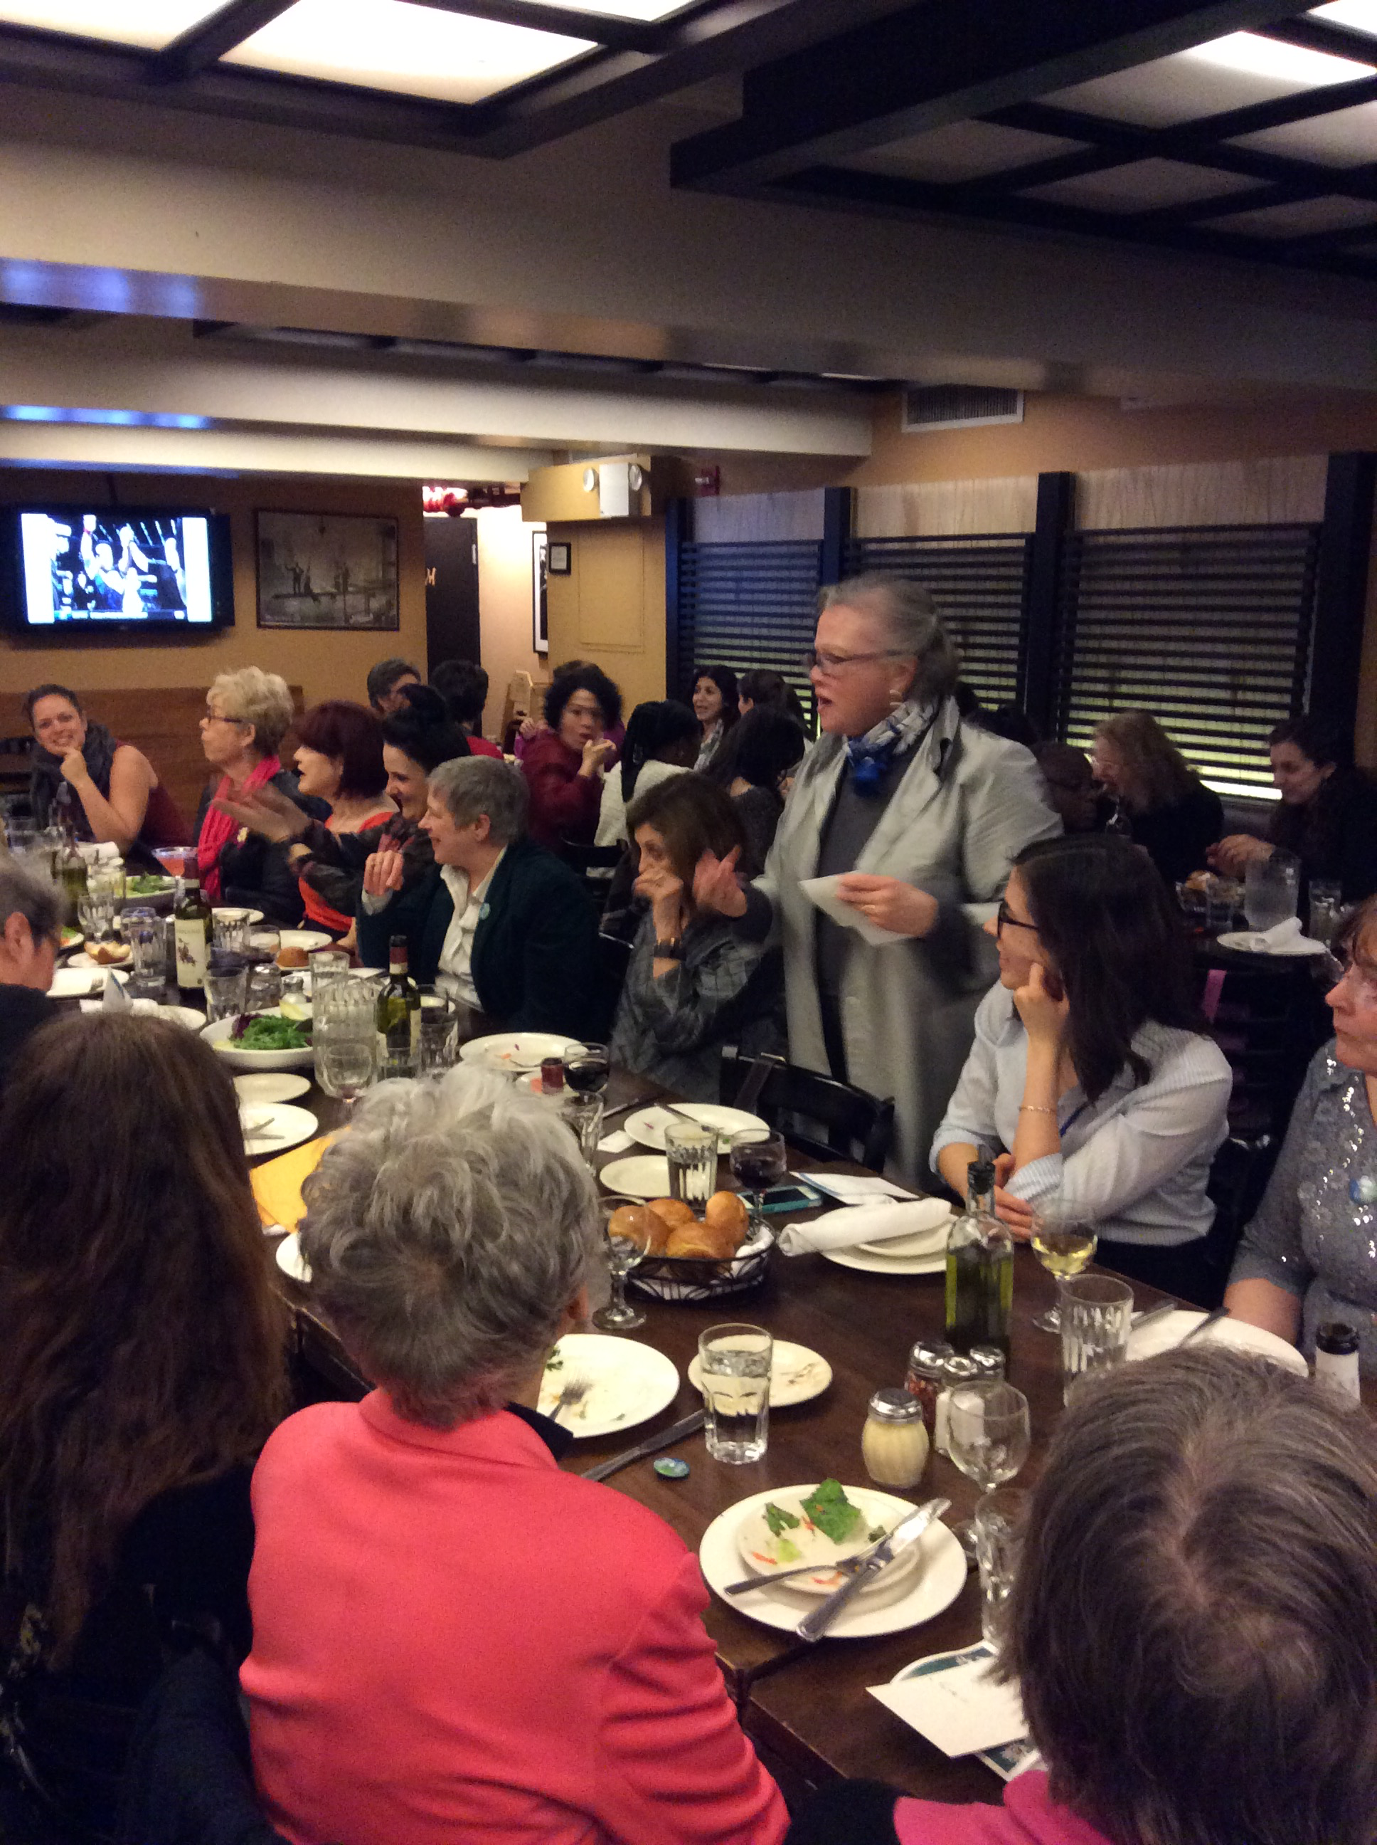

Slide 15
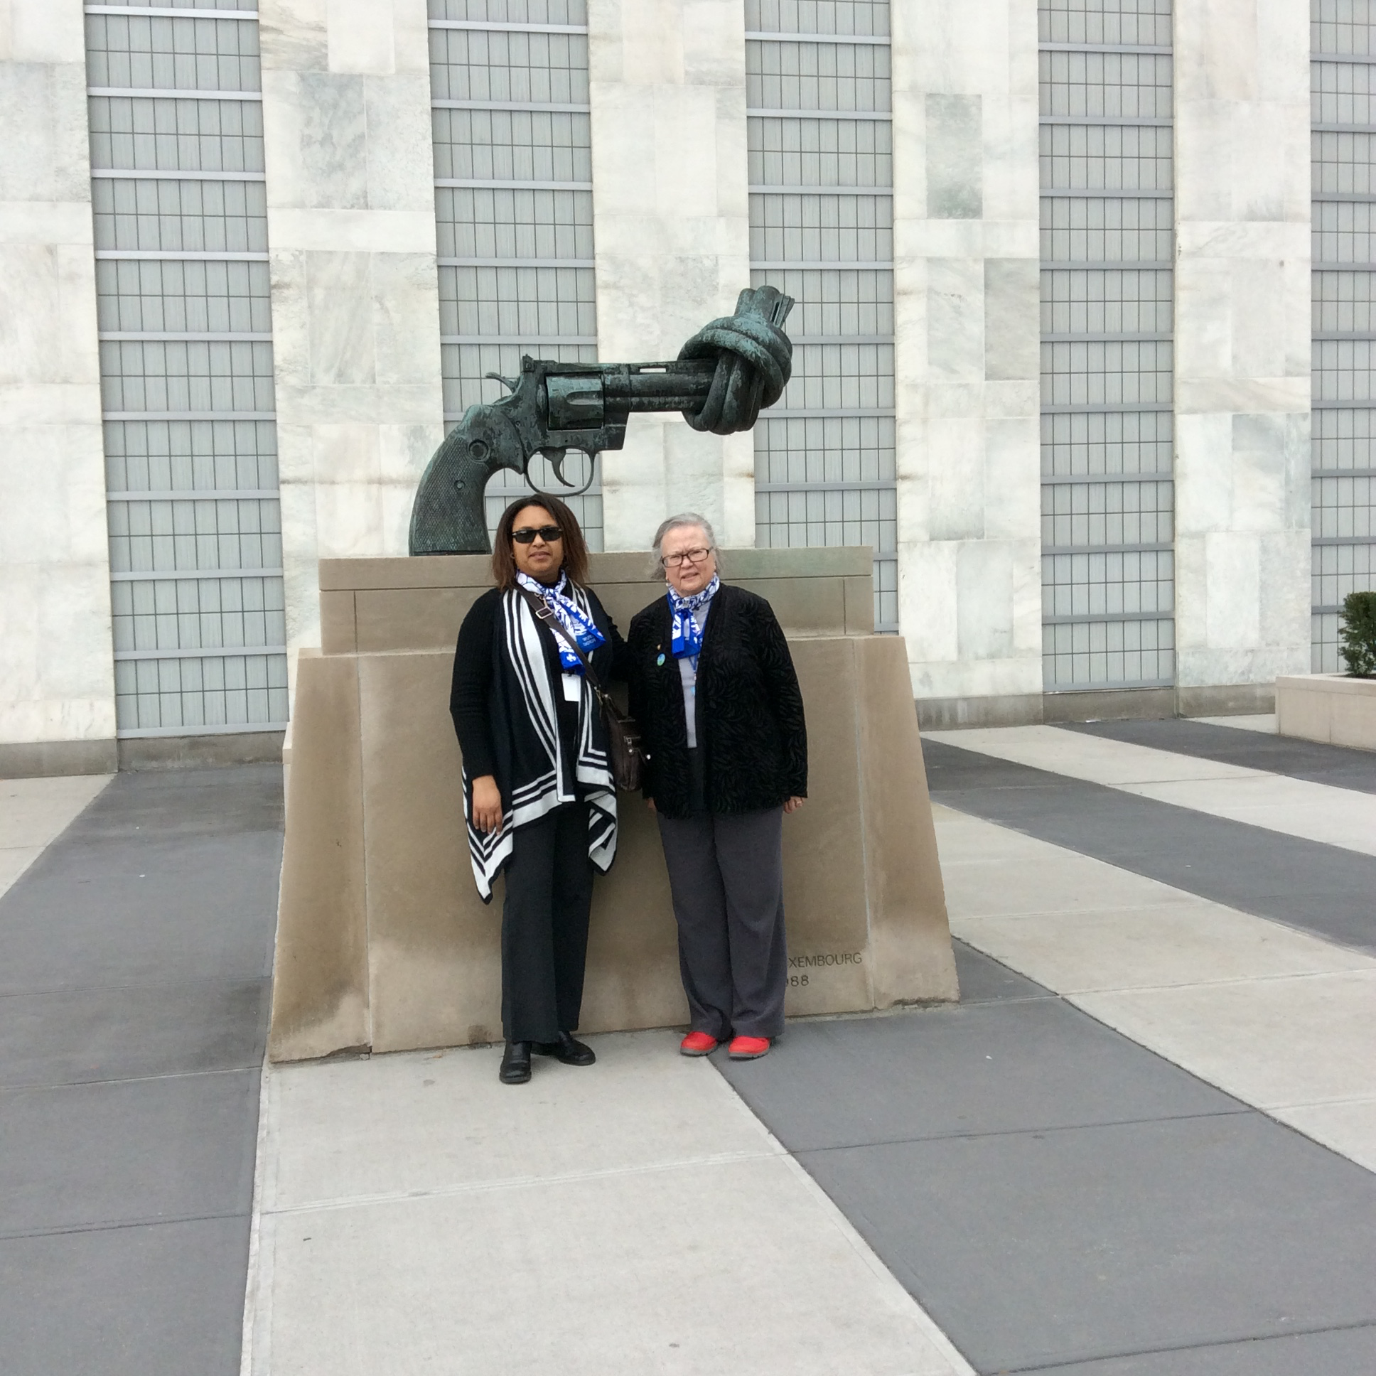

Slide 16
Meeting with Giles Norman at the permanent mission of canada to the un

Slide 17
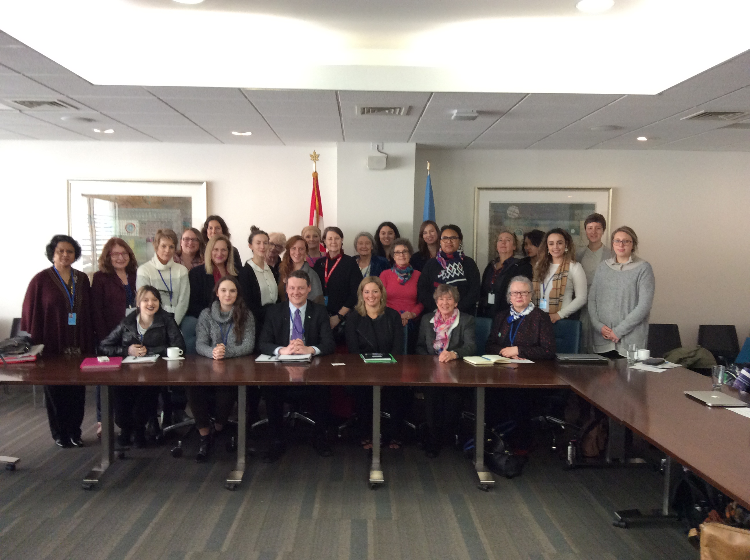

Slide 18
“NEW YORK—Justin Trudeau told a United Nations conference that he foresees a generational shift, as more parents raise their kids to embrace the term as an endorsement of basic equality.
“I’m going to keep saying, loud and clearly, that I am a feminist.”
ALEXANDER PANCETTA -The Canadian Press
Thurs., March 17, 2016

Slide 19
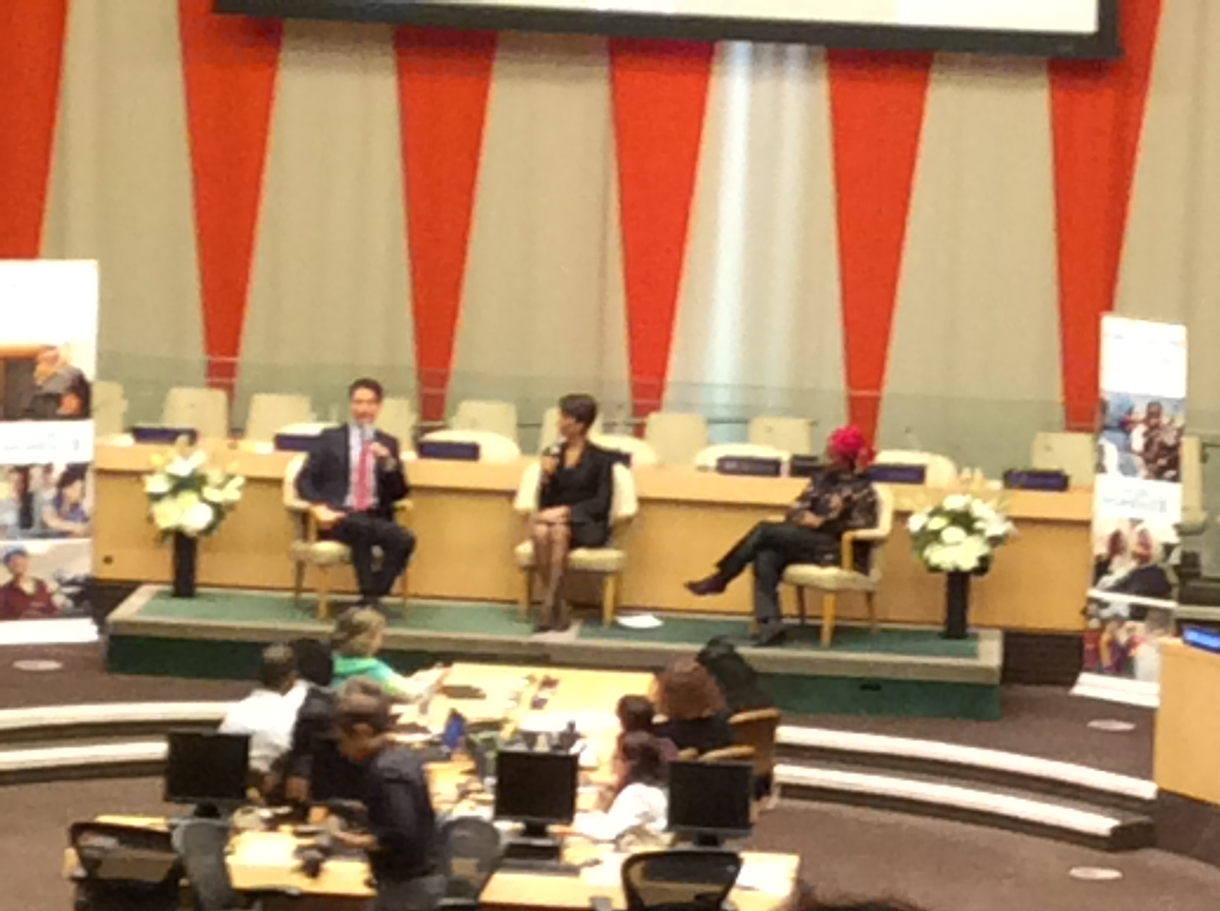

Slide 20
Canada elected to United Nations Commission on the Status of Women
A seat on the Commission gives Canada a stronger voice in advancing the rights of women and girls
April 7, 2016 – Ottawa, ON – Status of Women Canada
Canada has been elected to be part of the governing body that sets priorities for the United Nations Commission on the Status of Women (UNCSW). By gaining a seat, Canada will be at the table to shape the Commission’s work to advance the rights of women and girls around the world.
Source: News Release, Government of Canada

Slide 21
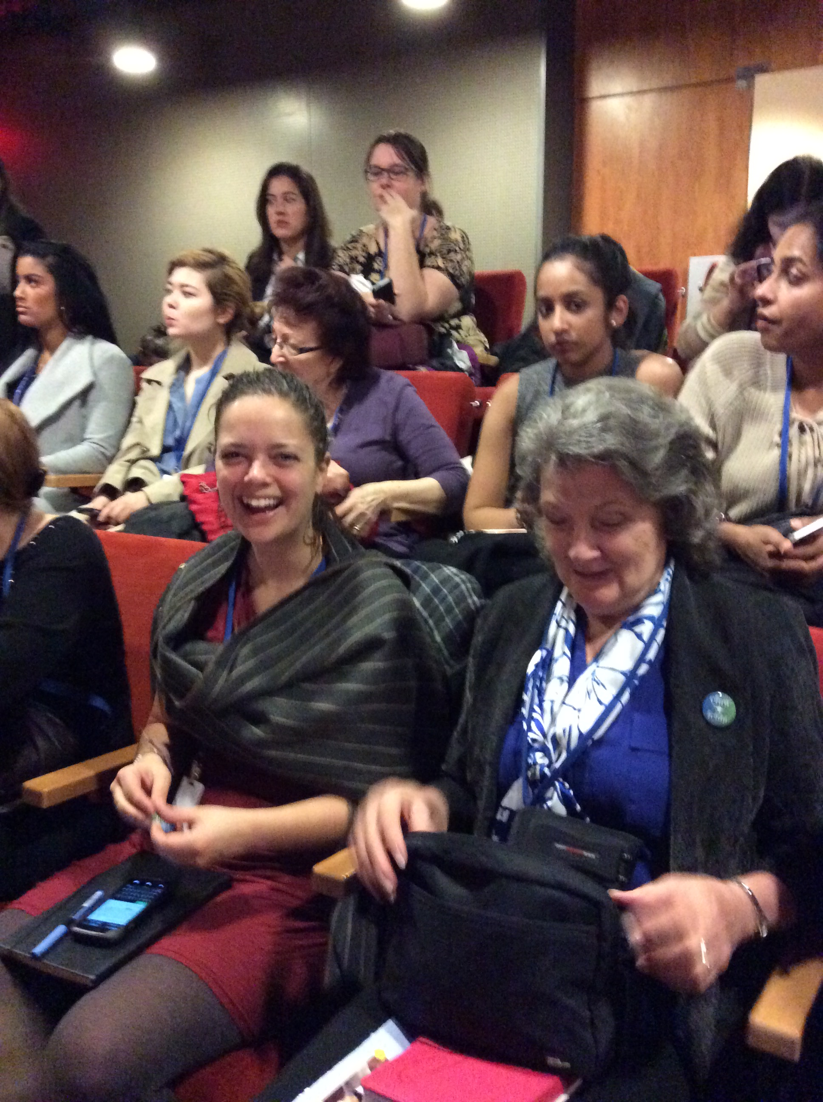

Slide 22
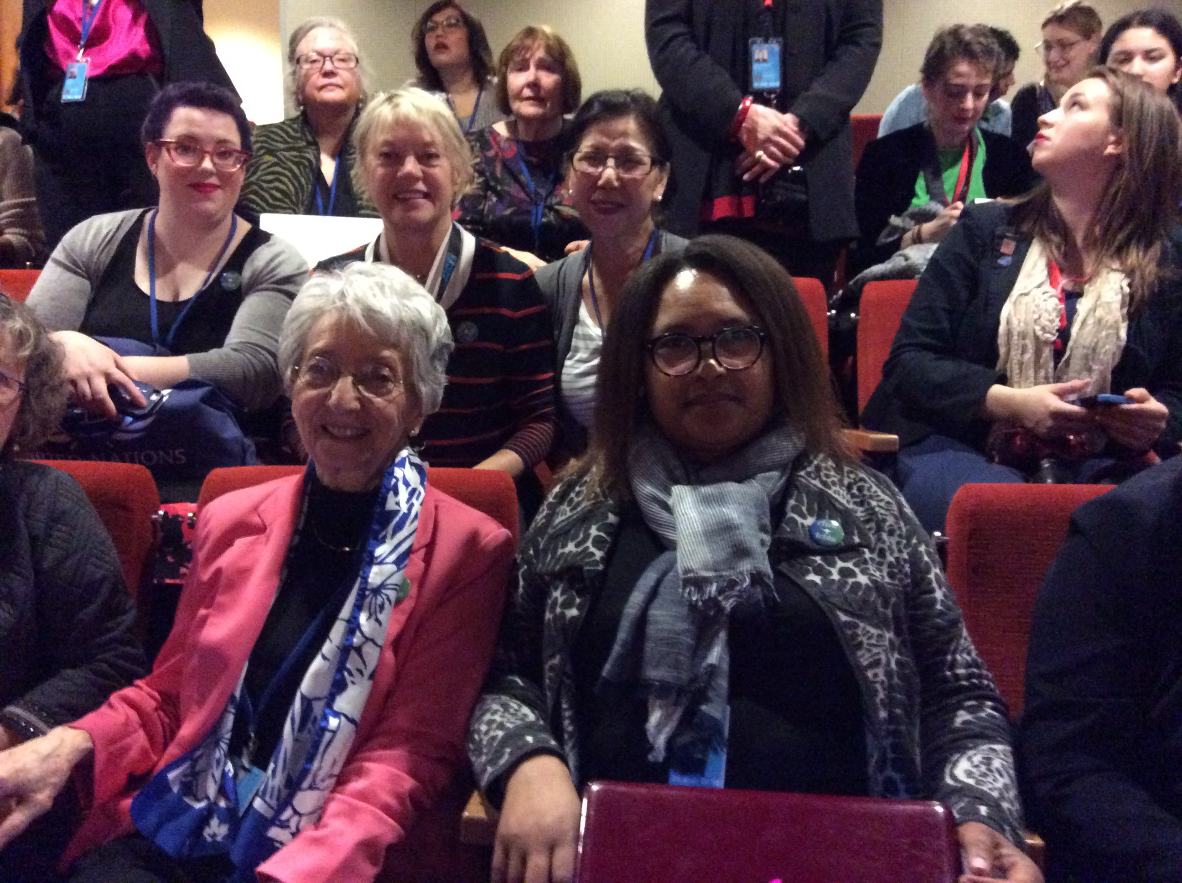

Slide 23
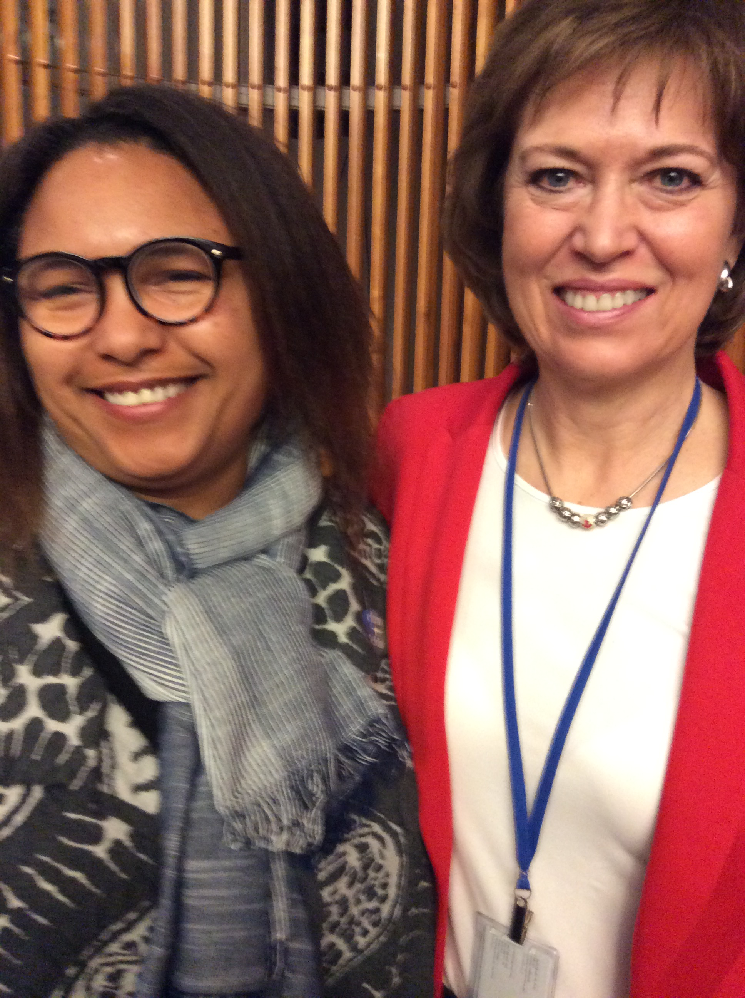

Slide 24
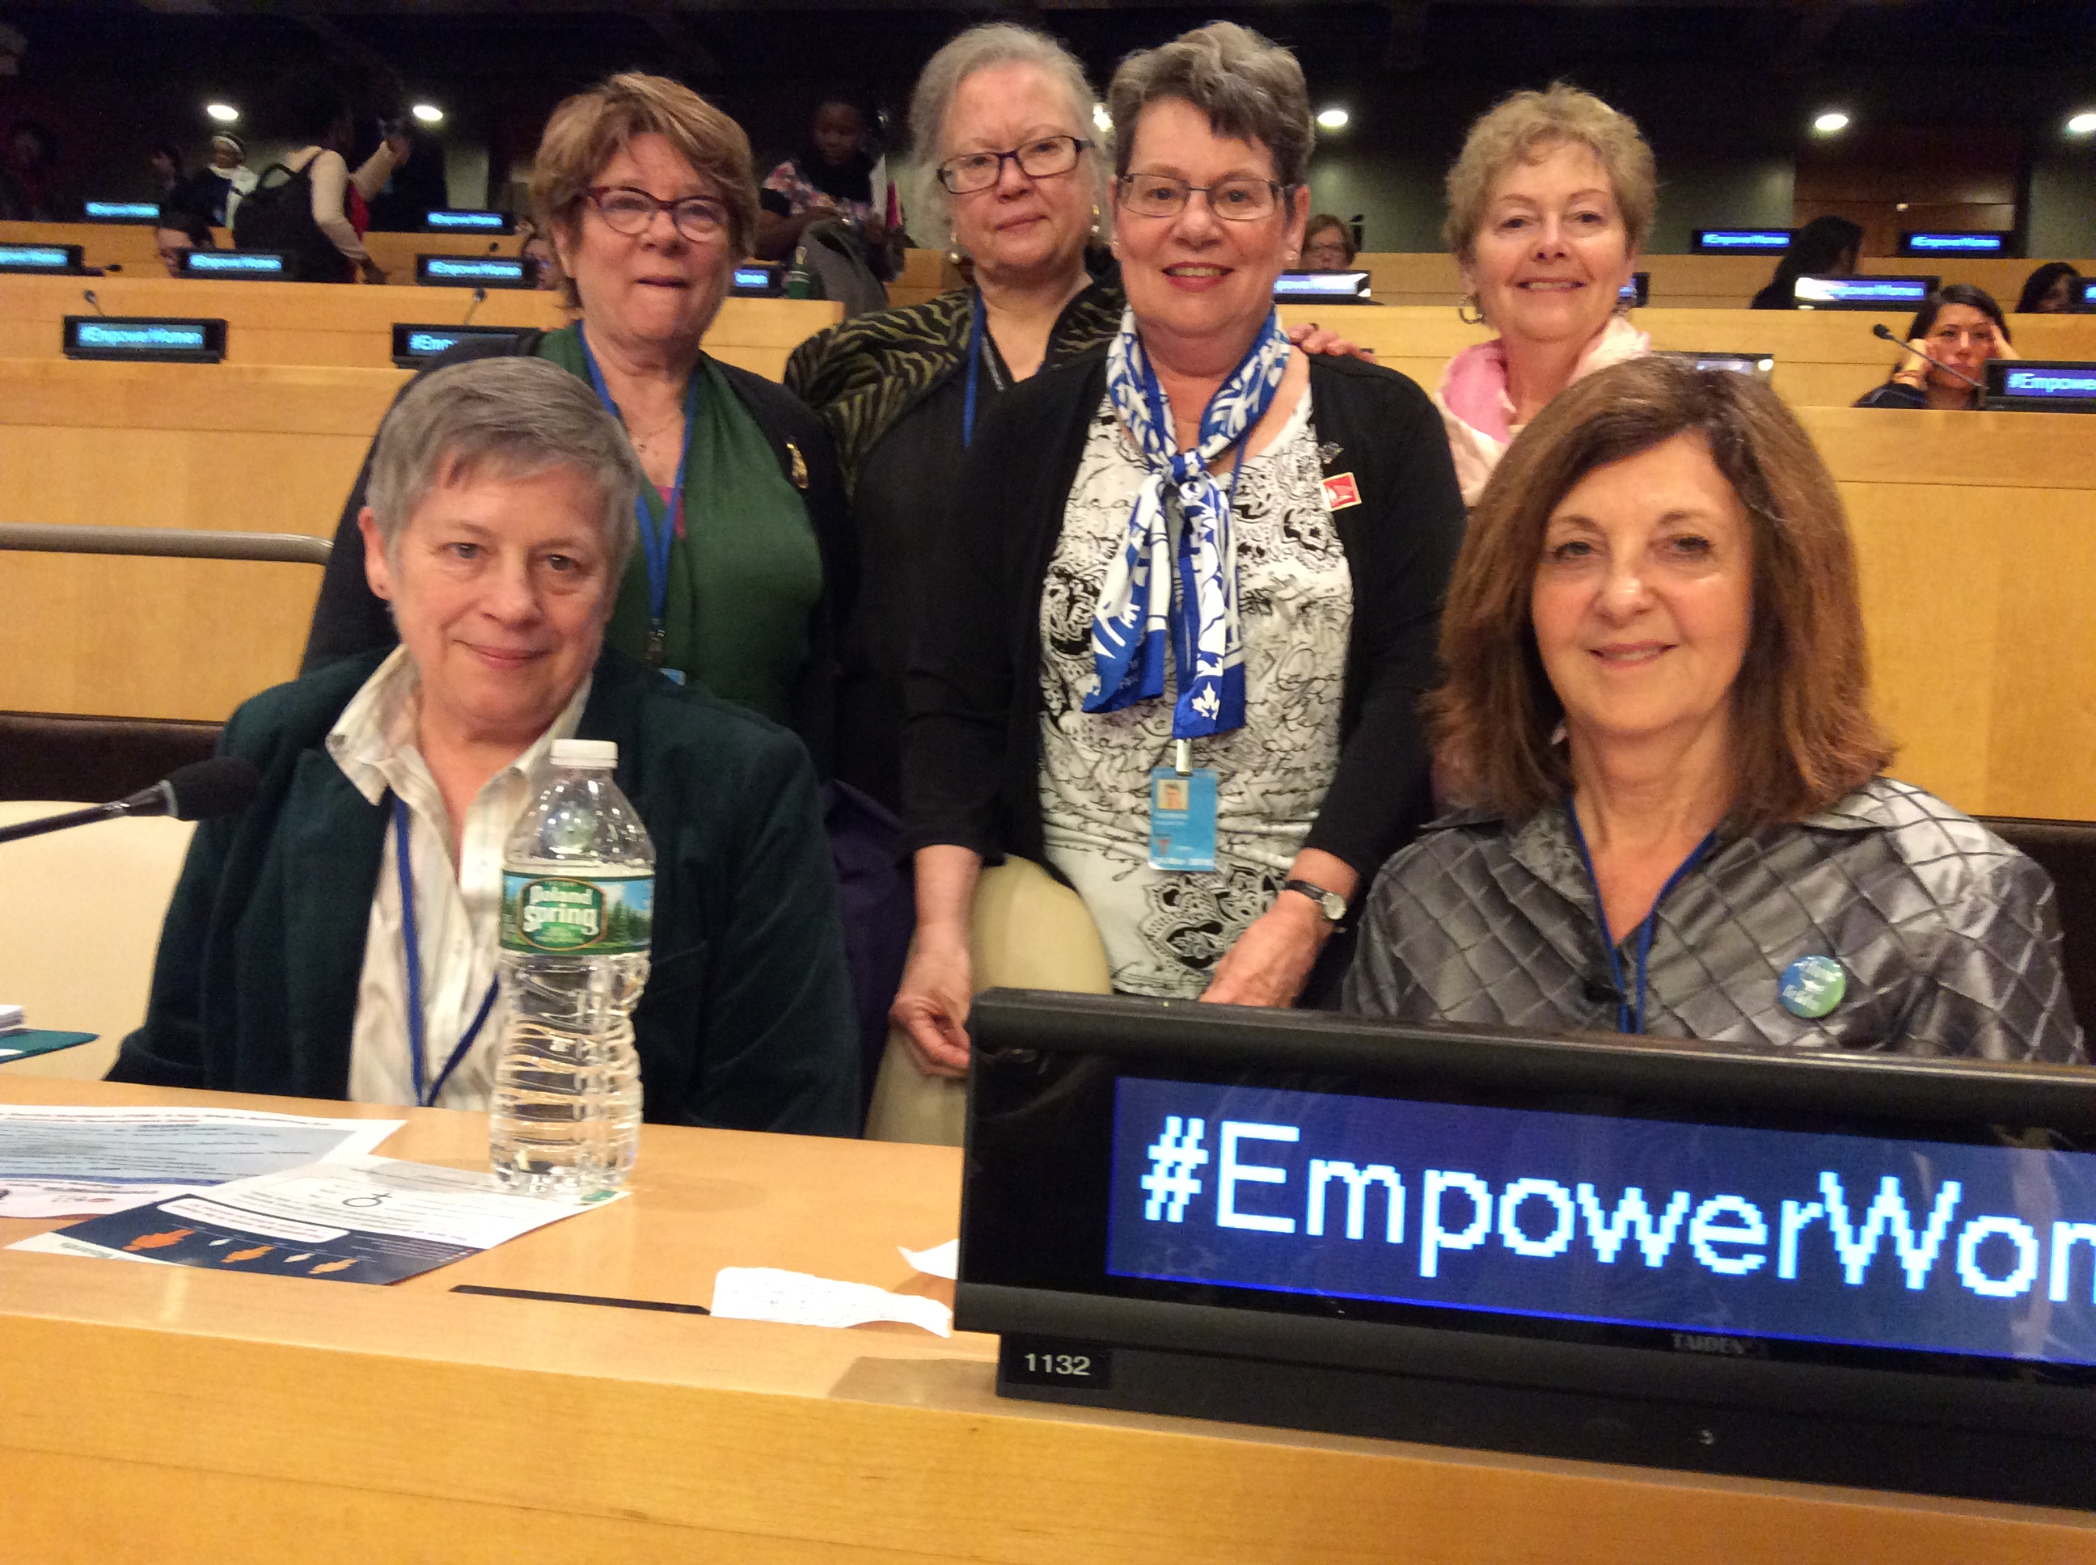

Slide 26
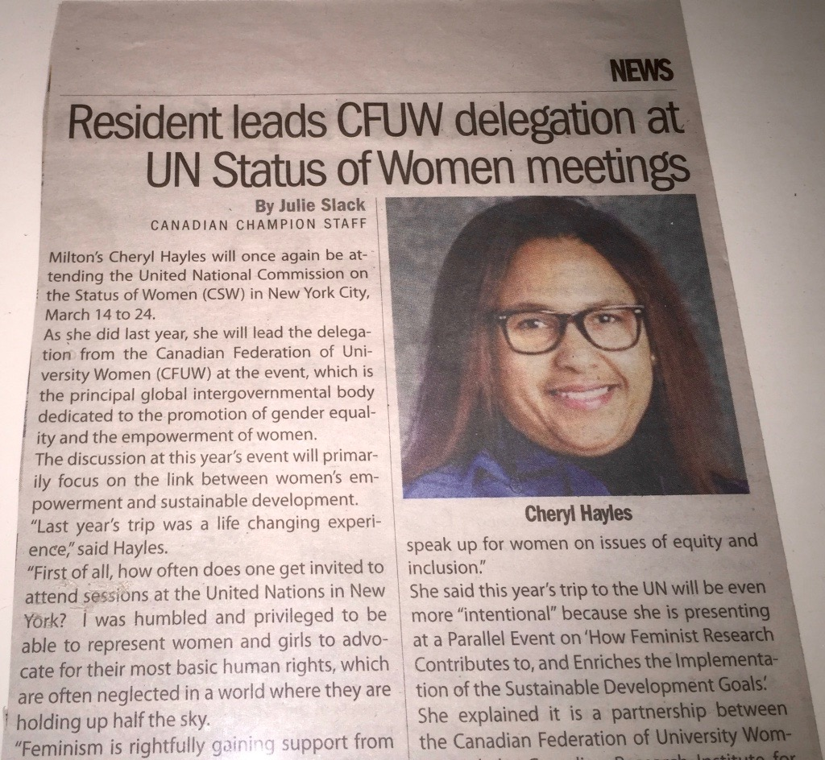
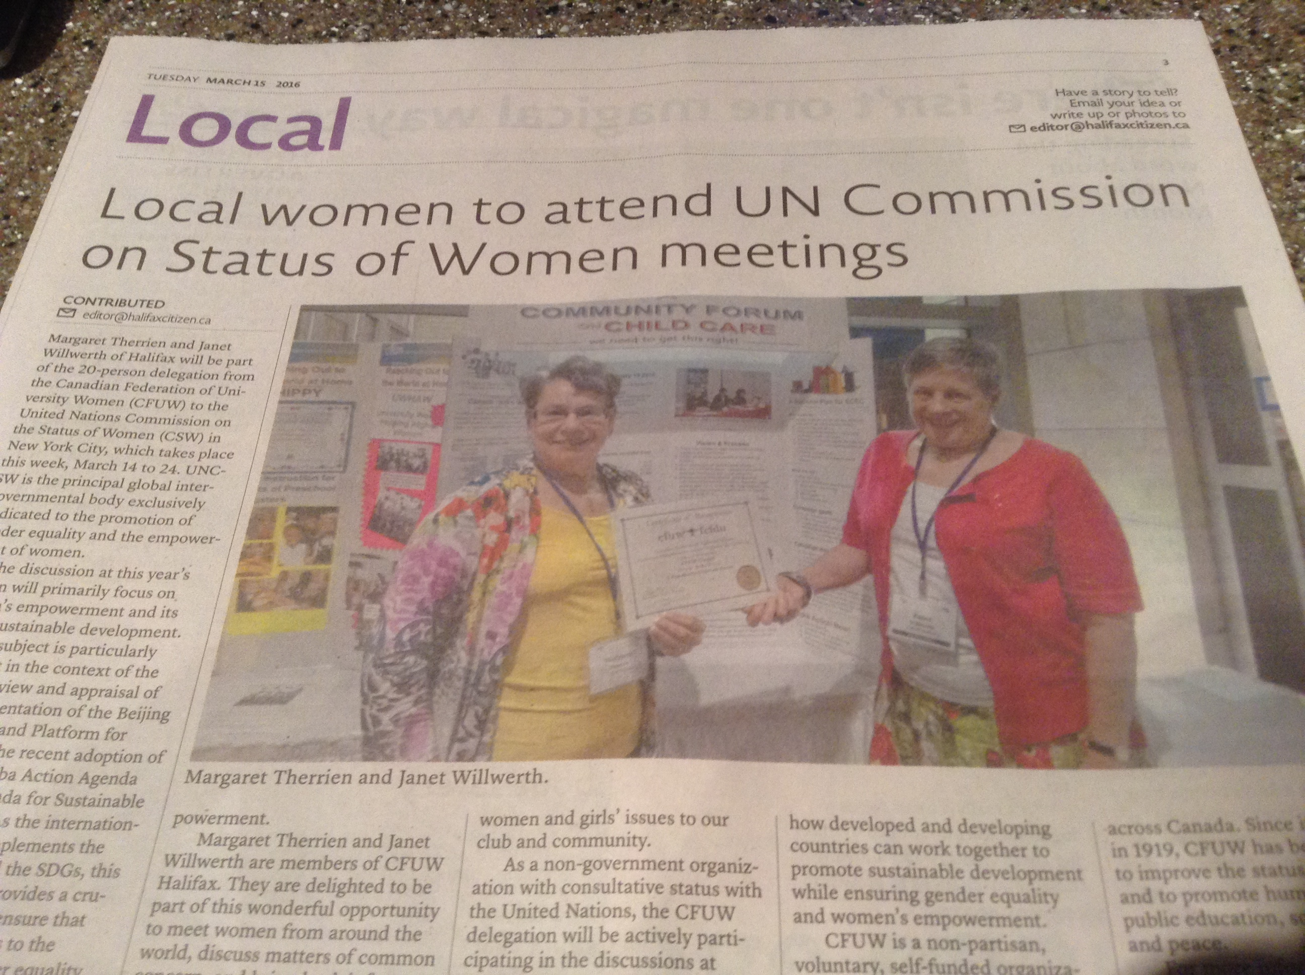

Slide 27
CFUW proposed 2 Parallel Events that were within the framework of the Priority Theme, Sustainable Development Goal #5.
We kept the spot in the first week during our time there, and donated back the spot in the second week.

Slide 28
How Feminist Research Contributes to, and Enriches the Implementation of the Sustainable Development Goals
This interactive session featured feminist research. How can the insights of feminism and feminist researchers make a contribution to monitoring progress in the implementation of the SDGs? Opening panelists reflected briefly on this question from their organizational and personal experiences. The session then encouraged discussion from the room and further networking about the research goals.

Slide 29
Panel
Linda Christiansen-Ruffman, ‘Reflections on Feminist Contributions to Research and Knowledge’
Nayyar Javed, ‘CRIAW’s role in capacity building for the post 2015 agenda’
Ann Denis & Marilyn Porter, ‘Feminist Research and Social Development Goals’
Cheryl Hayles, ‘CFUW’s Mentorship Program for Women in STEM, Politics and Organizational Leadership and its Evaluation’ - Action Research

Slide 30
The session balanced scientific research and application of research data. The second half of the session was designed to engage with the room and listen to what others are doing in their NGOs. We were able to give voice to 8 NGOs, each of which stemmed from different contexts, which addressed violence against women, fair trade, education deliverables and again stressing the importance of feminist data to effectively advocate for change.

Slide 31
The room was full to capacity with people standing at the back. This facilitated intimate interaction with the NGO community. After the session we had offers for future collaboration, people wanting to join CFUW and positive comments on our work.

Slide 32
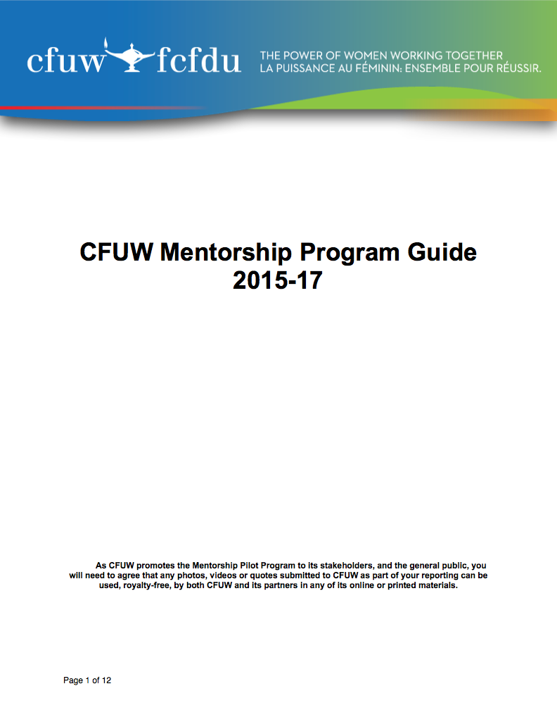
CFUW Mentorship Pilot Program
$73.05 on the dollar.
Education is not enough, therefore I call on my sisters for guidance.

Slide 33
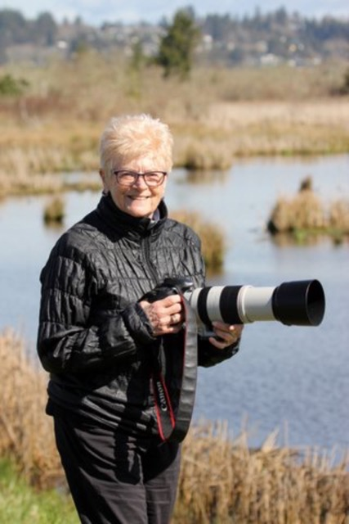
mentorship award
Dr. Madeline Kalbach of CFUW Calgary,
First recipient of the CFUW Mentorship Award.

Slide 34
Sustainable development
CFUW resolution

Slide 35
Follow Up Visit to the Hill
We have friends on the hill

Slide 36
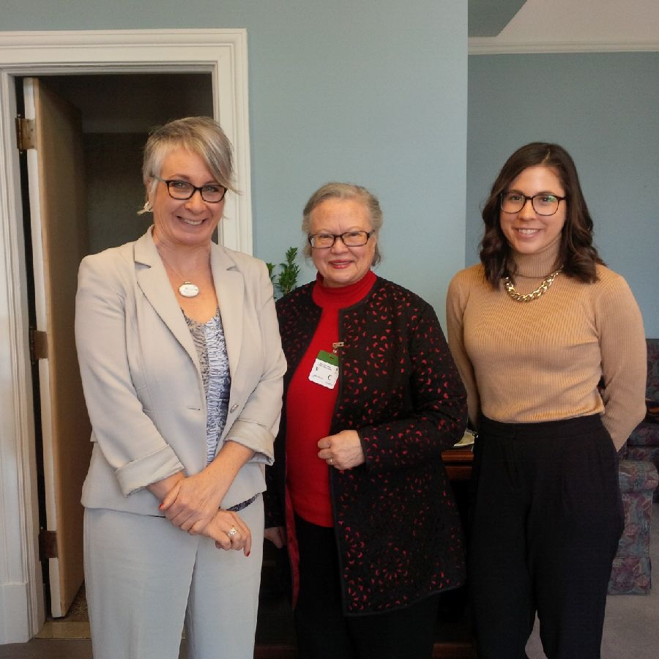

Slide 37
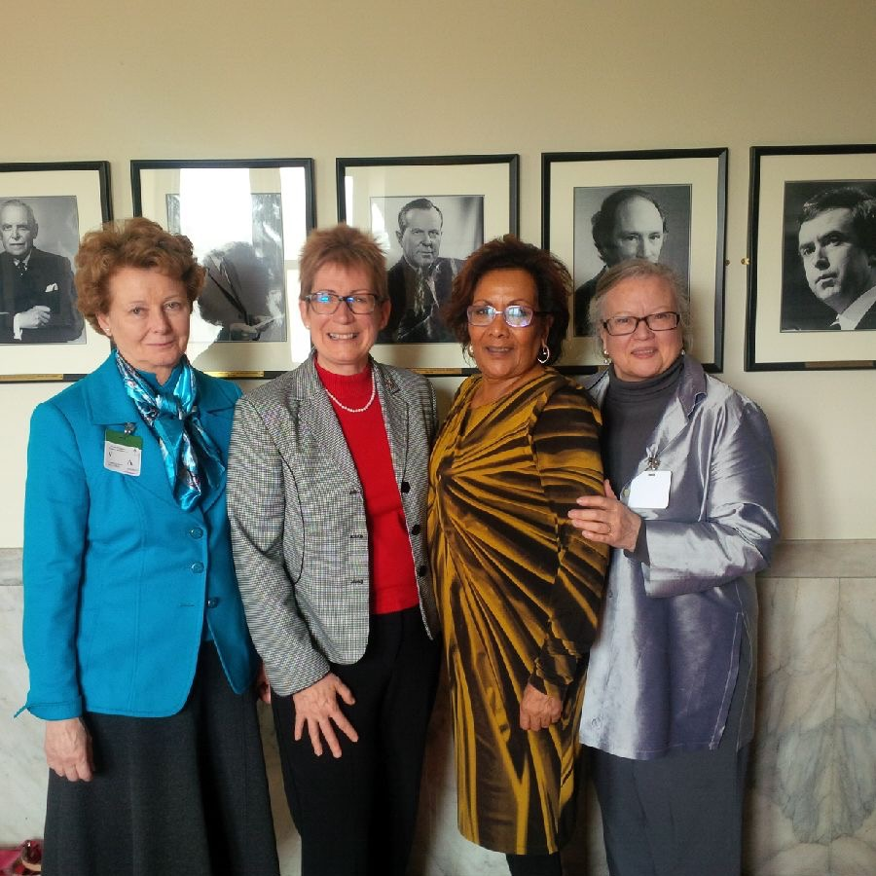

Slide 38
Global Affairs Canada Launches International Assistance Policy Review & Consultations
This review and consultations are being undertaken in an effort to renew Canada’s international assistance policy and funding framework and will contribute to informing the new government's process of refocusing Canada's international assistance.

Slide 39
“We are consulting with Canadians and partners to ensure that our actions help empower the most vulnerable and contribute to finding lasting solutions to the world’s most pressing development challenges. As we are demonstrating at Women Deliver, Canada has a long tradition of engaging internationally. We are a global people committed to a shared humanity.”
- Marie-Claude Bibeau, Minister of International Development and La Francophonie

Slide 40
These consultations will have the following thematic focuses:
• Support for the poorest and most vulnerable people and fragile states
• Women and girls and consulting on how to apply a feminist lens throughout all of Canada’s international assistance activities
• Shaping Canada’s approach to implementing the 2030 Agenda for Sustainable Development
• Making Canada’s approach, investments and partnerships more innovative and effective

Slide 41
All Canadians and partners have been invited to participate in this review which will run between May and July 2016.

Slide 42
International Assistance by Thematic Priority, Global Affairs Canada

Slide 43
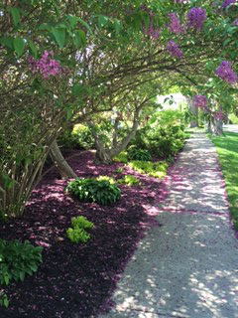
Securing the future of children and youth (Includes spending towards Maternal, Newborn, and Child health (MNCH)): $1,198.0 M (35%)
Humanitarian assistance: $814.2 M (24%)
Stimulating sustainable economic growth: $621.2 M (18%)
Increasing food security: $299.6 M (9%)
Multisector assistance, social development, and development engagement: $251.0 M (7%)
Promoting stability and security: $137.1 M (4%)
Advancing democracy: $118.2 M (3%)
Canada's total international assistance: $ 5.8 B

Slide 45
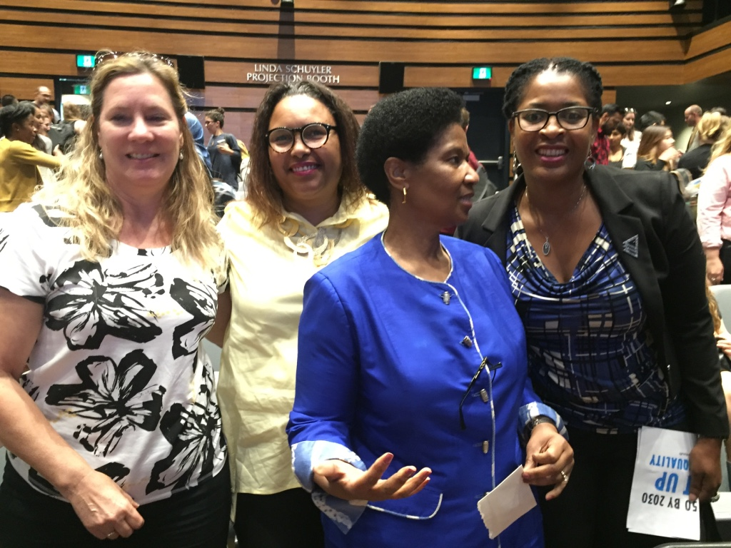

Slide 46
International Relations committee award
THE HOPE PROJECT – funding education of secondary school girls in developing countries since 2005.
CFUW Salt Spring Island (SSI); the Hope Project Committee organizes fundraising
and administers the project; club members contribute items to annual fundraising auction, make cash donations to the project or individually sponsor the education of a girl.
Victoria Olchowecki (President); Hilda Spendjian (Hope Project Chair)

