Slide 1
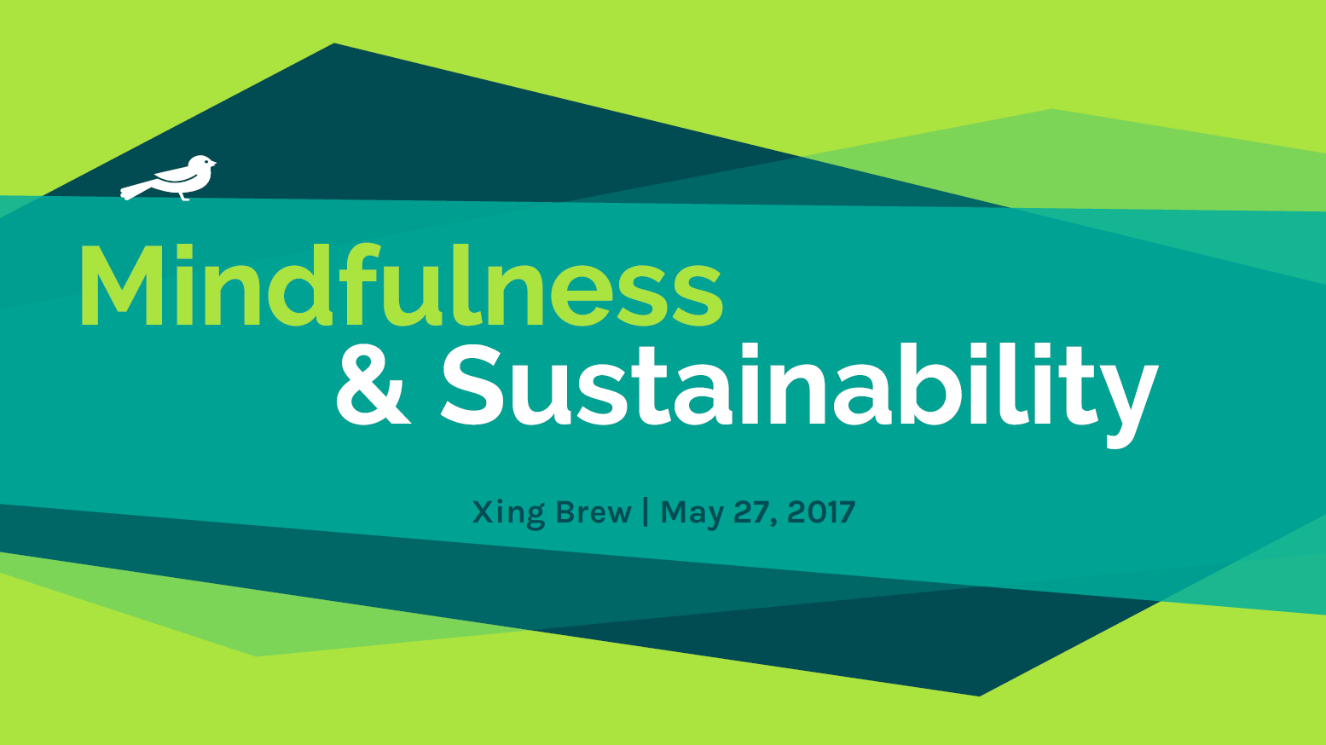

Slide 2
If the world’s 7 billion people lived like North Americans, we would need approximately four earths to sustain us.
(Global Footprint Network, 2011)
In the next 20 years, up to 3 billion more middle-class consumers will emerge in addition to today’s 1.8 billion.
(McKinsey, 2011)

Slide 4
In 2016, there were more
than 65 million displaced people in the world due to conflict, economic pressures or climate change.
Zamboanga, Philippines

Slide 5
An integrated approach to addressing sustainability
R&D and technology
Policies and agreements
Traditional knowledge
Education
Social dimension: norms, culture, values, consumption habits

Slide 6
Mindfulness
“Awareness that arises through paying attention, on purpose, in the present moment, and nonjudgmentally.” (Jon Kabat-Zinn)
A quality of being in which thoughts and feelings are observed as events in the mind, without over-identifying with them or reacting to them in an automatic pattern of reactivity.

Slide 7
Compassion and empathy
Mindfulness has been shown to increase people’s empathy and compassion, and felt connection with other people and the world around them.
(Brown et al, 2007; Shapiro et al, 1998)

Slide 8
Connectedness with the Earth
"You carry Mother Earth within you… She is not outside of you. Mother Earth is not just your environment… So breathe in and be aware of your body and look deeply into it and realise you are the Earth and your consciousness is also the consciousness of the Earth.
Not to cut the trees, not to pollute the water, that is not enough."
Thich Nhat Hanh

Slide 9
Health and well-being
Mindfulness has been proven to improve well-being and
health-related conditions, including chronic pain, stress, anxiety, depression, and immune function.
(Brown et al, 2007)

Slide 10
Conscious behaviour

Slide 11
Antidote to consumerism
Much of our behaviour as consumers is automatic and influenced by unconscious choice
Lack of connection and meaning is cause of consumption
Studies have shown that mindfulness...
fosters increased self-control and self-regulation
may serve as an “antidote to consumerism” by enhancing fulfillment through non-consumer experiences (Rosenberg, 2004)

Slide 12
“Building peace in the minds of men and women”

Slide 13
Meditation is the training of attention and the mind which cultivates mindfulness.
It isn’t about letting your thoughts wander or emptying your mind. Instead, the practice involves paying close attention to the present moment — especially our own thoughts, emotions and sensations — whatever it is that’s happening.

Slide 14
Let’s meditate!

