Slide 1
Members Getting them & keeping them

Slide 2
How do we go about attracting new members and keeping members?
Successful Strategies
ideas to implement them
linking to your community,
raising your profile and strengthening your club

Slide 3
Successful Recruitment Strategies
Personal invitations from Club members 76%
Distribute Club materials 53%
Contact recent retirees 37%
Sponsor public forums 32%
Source: New Beginnings Survey 2013
Notes:
Use a club anniversary to have a special event inviting people from the community – former members, like-minded groups, recent retirees

Slide 4
(Recruitment Strategies, con’t)
Club open house 28%
Sponsor seminars 20%
Distribute national CFUW materials 16%
Club website 10%
Interest groups 9%
Source: New Beginnings Survey 2013

Slide 5
What Can You Do? List of Ideas
1st Category: Linking With the Community
Public Forums, etc
Public Forum: Raising Children Out of Poverty - How?
Public Forum “The Aliens among Us”
Public Lecture & Forum on Sustainable Energy in SE Asia
Town Hall Meeting on "Idle No More" Movement
Public Meeting: "Local Perspectives on Climate Chang, A Call to Action"
Public Forum "Family Law Education for Women".
Public Forum: Oka to Attawapiskat
Public Forum on The Power of Local Food
Public Forum on Polygamy: Right or Wrong
Open Forum on Youth and Opiate Addiction
Open Forum on Treasuring the Tay as part of a water campaign
Provincial All-Candidates Forum
Black History Month Presentation on Black Pioneers of Alberta
Public Showing of "Poor No More film"
Presentation by I Shall Not Hate author- part of Community Diversity event
"Status Quo" showing and panel discussion
Lunch and Speaker in honor of the 100th ann. Of International Women's Day
IWD programme – Aspect of Women’s Humanity: our sexuality.
Persons Day: Inspiring Women Then and Now (Speakers)
Source: CFUW AGM 2013 Membership Workshop

Slide 6
List of Ideas, con’t
Public Service Projects
Give & Take Bookshelves
IWD "It's Just Mutually Beneficial" Event with a Women's Shelter
Habitat for Humanity Build Day
Gower Street Lunch Program for Inner City Residents
Inventory of Mid-Island Projects
Neck Supports for Seniors in Residential Care
Manning a Salvation Army Kettle
Pneumonia Prevention Vests for Babies in Africa & Asia
HIPPY Project (Home Instruction for the Parents of Pre-School Youngsters)
Fresh Start Baskets for Women Leaving Shelters
Health Series of 5 dinner/lectures
Free Wellness Series for seniors
U. Of Alberta Food Bank - collection
Community Garden project as part of their Food Security advocacy
Kind Deeds With Kraft Dinner
Source: CFUW AGM 2013 Membership Workshop

Slide 7
List of Ideas, con’t
Fundraising
Christmas Concert by the Cool Chicks & Ugly Doclings
Fashion Show: "Wedding Gowns Through the Century"
Winnipeg Steel Orchestra Concert
Musical Lunch & Silent Auction for Afghan Girls
IWD Eve Slave Lake Women's Shelter Fundraising Luncheon
Historical Fashion Show & Buffet Dinner
Guitar Groovers Public Performances
Fundraising Concert Featuring Public School Students
Source: CFUW AGM 2013 Membership Workshop

Slide 8
List of Ideas, con’t
Category 2: Programs & Projects
Welcome Event for Students from Jinan U. (China)
Design, Approval & Public Unveiling of Geneva Misener Plaque
Exhibition of "Extraordinary Lives: Inspiring Women of Peel"
IWD Amazing Women Celebration
Townships Walking Calendar
Scientists in Schools
Student Mentorship Programme
the Toilet Project in Ethiopia.
Adopt a Family Project
First in Last Out”RCAF -Women’s Division in World War 1
Writing contest with newspaper
30th Anniversary Reunion w. Scholarship recipients
Source: CFUW AGM 2013 Membership Workshop

Slide 9
List of Ideas, con’t
Interest Groups
Out to Dinner
Out to the Movies
Book Club
Armchair Travel
"Gourmet" groups
Music study groups/concert groups
Walking/Hiking
Cross-country skiing
Conversational French, Spanish, etc.
Source: CFUW AGM 2013 Membership Workshop
Writing/Journaling
Investment or financial literacy
Bridge
Complementary Approaches to Wellness
New Book Exchange
Wine Appreciation
Issues & Resolutions
Environmental Studies

Slide 10
List of Ideas, con’t
Category 3: Publicity
Use new CFUW Branding templates: brochure, press release templates, etc.
Up to date website
IWD Flash Mob
Have local TV tape a fun activity (hiking group walk – Kelowna did this)
Membership Marketing Video
Advertising in local newspapers
Flyers in libraries, churches, other public places, Welcome Wagon,
Info in local town literature listing club activities
Table at Community Open House
Ads placed in local university alumni magazines
Monthly articles in the local newspaper
Approaching other agencies for small group casual 'coffee conversations'
Open Houses/Guest Nights/Food and beverage receptions
Source: CFUW AGM 2013 Membership Workshop

Slide 11
The Plan
Step 1: Choose something from each of the 3 categories to work on.
Base the decision on what is most feasible for your club, and what will give you the most return for your effort.

Slide 12
Sample worksheet for making your plan:
Linking With the Community
Possible Activities | Advantages | Disadvantages | Yes/No/ Later

Slide 13
Visible Programmes, Projects, Interest Groups
Possible Activities | Advantages | Disadvantages | Yes/No/ Later

Slide 14
Publicity
Possible Activities | Advantages | Disadvantages | Yes/No/ Later

Slide 15
Step 2: Make a plan for accomplishing the objectives
- what (list of actions)
- who (is responsible)
- how (effort/cost)
- when (due date)

Slide 16
Linking With the Community Activities
Action | Who | Effort/Cost | When

Slide 17
Visible Programmes, Projects, Interest Groups
Action | Who | Effort/Cost | When

Slide 18
Publicity Activities
Action | Who | Effort/Cost | When

Slide 19
Step 3: Follow up
- Present this plan to your Club Executive & members (Get their buy-in)
- Set a schedule to check on progress. Some actions need to be followed more often than others
- Decide who will review the progress - If it doesn't work out, try something else instead.
- Attend the follow-up conference calls

Slide 20
Membership Tips: Plan to be Visible
The most important factor in building a Club's membership is to increase its overall visibility in the community. After all, no matter how good you are, they can't join you if they don't know you exist! And now is a great time to get your programme ready for next year.
Women will be attracted to groups that are well known and respected, that provide opportunities for friendship and the pursuit of personal interests, and that are involved with initiatives for the greater good.
Source: CFUW Press Agency - April 25, 2014

Slide 21
Membership Tips: Plan to be Visible
First, know your community: check out who lives there, and who is moving in, so you know who your target audience is.
Next, check out issues of local interest and upcoming events. Then, get out there and be part of things.
Source: CFUW Press Agency - April 25, 2014

Slide 22
Here are some ideas that have worked for other clubs.
Participate in community events and don't be shy to say who you are (practise your elevator speech; handout business cards).
Join with other like-minded organizations in celebrating events and/or advocating on issues important to the community and to the CFUW Mission. This is particularly useful for smaller clubs with limited resources.

Slide 23
Here are some ideas that have worked for other clubs.
Have some meetings that are open to the public and plan them with community issues and resources in mind. Be sure to advertise them - most communities have opportunities for free publicity (Fredericton had a speakers series & got a 10% increase 2 years in a row).
Be accessible! Meet in a public venue and be sure that activities are held at a time when working women can attend. Offer to provide rides for members with transportation problems.

Slide 24
Here are some ideas that have worked for other clubs.
Offer some ongoing special service to the community such as electoral or other forums, or scholarships (and make sure people know that you are the sponsor!)
Offer Interest Groups that are attractive to women in your community. It is important to offer Book and Dining groups, but in some communities activities such as walking/hiking and bridge might also be popular. Don't be afraid to try new ones - it's inexpensive and fun.

Slide 25
Here are some ideas that have worked for other clubs.
Be accessible! Meet in a public venue and be sure that activities are held at a time when working women can attend. Offer to provide rides for members with transportation problems.
Offer some ongoing special service to the community such as electoral or other forums, or scholarships (and make sure people know that you are the sponsor!)

Slide 26
Here are some ideas that have worked for other clubs.
And finally, don't forget that it's OK to brag a little! Tell your local newspaper, radio or TV station about your Club's activities and accomplishments and be sure to post them on your Club's website and Facebook page (National's as well).
Use our tag line on all your media pieces:
The Power of Women Working Together
La puissance au féminin: ensemble pour réussir
with your website address (or the national one) included

Slide 27
Kick-starting Your Recruitment Campaign
Have a table at a town festival with brochures (Pickering)
Hold an author`s night open to the entire community. Talk about the Club.
Ask existing members to bring 2 new members
Most successful to bring friends – personal recommendation of the club<Highest retention value is when they come with a friend (Pickering)
Open house in condo community room and surrounding buildings (North York)
Pickering tried luxury retirement complex open house – but no interest. They also set up a table at Bell retirement group – no recruits yet
Use a draw to pull in people
One club is planning to go to Zoomers shows. Maybe all Toronto clubs should get together on a recruitment plan. One club had a problem getting members to work at a table
Source: 2014 AGM Membership Workshop Notes

Slide 28
Kick-starting Your Recruitment Campaign
Put ads in the local paper about upcoming programs<Put events in local calendars<Communicate!
Invited versus open – we will die off if not open
Important – embrace/ buddy
Most members from big book sale – have a table there
First meeting is open house
Unsure how many people at universities know about CFUW – we need publicity re CFUW nationally, done nationally at all universities
Need better partnerships with universities receiving scholarships
Common groups to approach:
Retired teachers - Probus
Retirement groups - Zoomers
Source: 2014 AGM Membership Workshop Notes

Slide 29
Retention - we want women to stay
Have a variety of Interest Groups including a community project group
Have open meetings, especially with a high profile speaker ( could charge a small fee for non-members)
Have an interesting Monthly program
Have meetings at convenient times & places
Have a Greeter at the door to welcome attendees
Have a new member buddy program (assign a buddy as soon as a new member joins)
Encourage new members to be involved: join interest groups, be on the Executive, etc.
To help members get to know each other, break up into small groups at the end of the meeting to discuss a topic such as: What 3 things are on your bucket list, or What career would you choose if you were to start over. Source: Ideas from membership calls 2013-14

Slide 30
Retention - we want women to stay
Have some Saturday lunch meetings in bad weather months.
Offer a “need a ride” service to members with transportation problems
Circulate materials from National Office
To reach members who don’t come to meetings, try talking at the interest groups about some of the other club activities.
Let your volunteers know you appreciate them. Use thank you notes, certificates, etc.
Member recognition: have a dinner and/or presentation for long-time members (30, 40, 50 years), or for members who graduated in a specific decade (1940s, 1950s, etc) and talk about the women. Source: Ideas from membership calls 2013-14

Slide 31
Notes:
Event, Issue, and Program Ideas for Clubs – May 21st New & Updates

Slide 32
CFUW National Initiative: Preventing and Responding to Violence against Women
Since launching the National Initiative on Violence against Women and Girls in 2013, clubs have enthusiastically embraced the initiative. We have featured many of the activities in The Communicator last May and on the website (http://www.cfuw.org/en-ca/clubsandcouncils/nationalinitiativeclubactivities.aspx).
Again this year, we will highlight the work done and have presented VAW awards at the AGM. In addition to the activities at the club level, CFUW National has worked on the issue as well.
Notes:
Liette -- Check out the 2013-2014 Idle No More Year in Review! http://www.idlenomore.ca/inm_year_in_review_2013_14

Slide 33
CFUW National Initiative: Preventing and Responding to Violence against Women
Presently, National is working closely with the Canadian Network of Women Shelters and Transition Houses, the YWCA Canada and others involved in the VAW sector to accomplish a number of goals:
Raise public awareness about the issue in the lead up to the federal election. Through the Alliance for Women’s Rights and the Up for Debate campaign, we are asking political parties to incorporate a strong policy response in their election platforms and commit to a federal leaders’ debate on issues identified by women, particularly violence against women.
Encourage decisions makers to develop a more comprehensive policy response to end violence against women and girls. With a number of partners, CFUW contributed to a Blueprint for a National Action Plan on Violence against Women and Girls, which was just released late February 2015.
Urge the Government of Canada to take stronger action to address the shocking number of Missing and Murdered Aboriginal Women and Girls. With the support of Clubs, CFUW collectively sent over 100 letters to politicians about this tragedy following the murder of Tina Fontaine.
Notes:
Liette -- Check out the 2013-2014 Idle No More Year in Review! http://www.idlenomore.ca/inm_year_in_review_2013_14

Slide 34
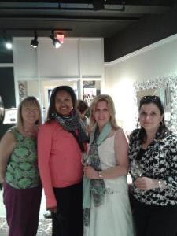
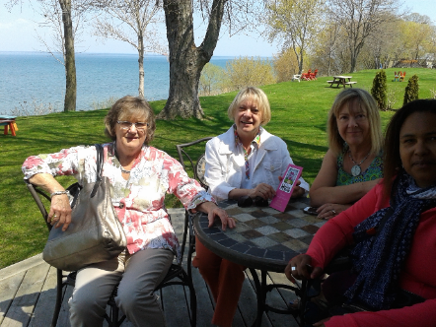
St. Catharines House Tour

Slide 35
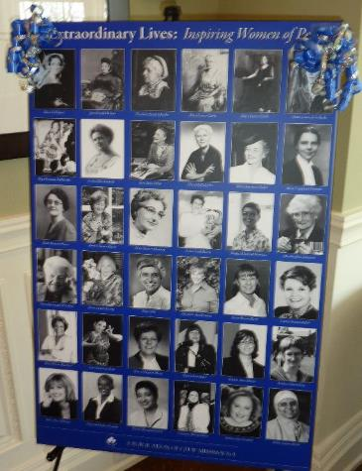
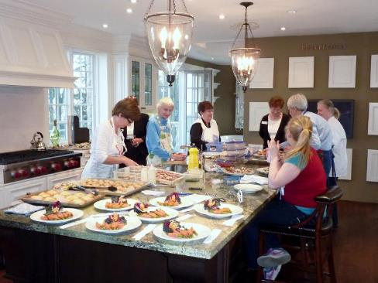
CFUW Mississauga – supporting the Charitable Trust $16,000 donated from sales of Extraordinary Lives: Inspiring Women of Peel

Slide 36
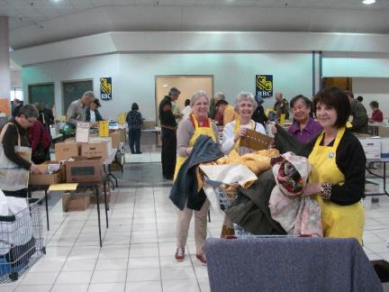
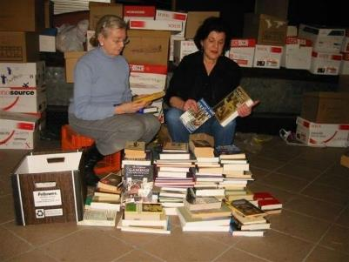
Book Sales - Fredericton
First held in 1964
Supports 11 scholarships
Named scholarships give special recognition to Club members who have contributed to the work of CFUW.

Slide 37
CFUW Regina 100 year celebration a ‘collective’ of past presidents

Slide 38
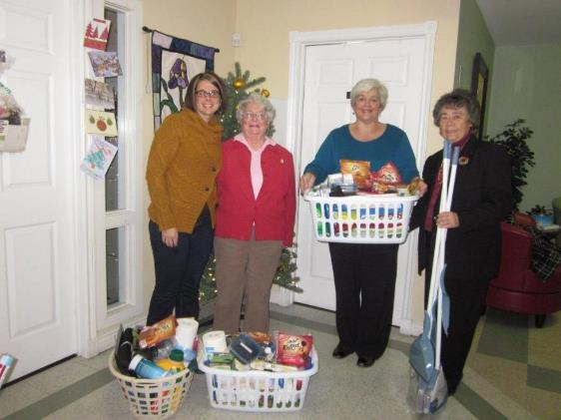
CFUW St. John’s members presenting "Fresh Start Baskets" to Iris Kirby House, a shelter for women and their children.

Slide 39
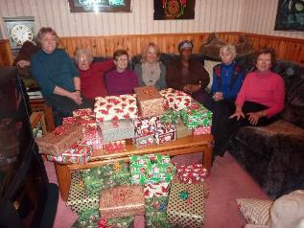
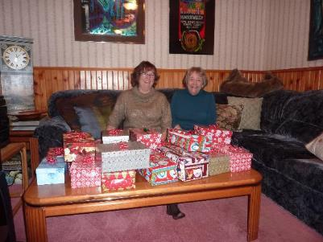
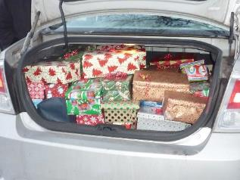
Shoeboxes for Shelters - Mississauga

Slide 40
CFUW friends enjoying events

Slide 41
New Items this Fall

Slide 42
Our VP (Alix) and our Finance Officer (Michelle) are at the University of Saskatchewan Welcome Week Festivities! Booth looks GREAT!

