Slide 1

I belong to CFUW because …

Slide 2
Who we are
A national, bilingual, independent organization striving to promote equality, social justice, fellowship and life-long learning for women and girls.
The Power of Women Working Together

Slide 3
Why CFUW matters …
Promotes high standards of public education
Supports advanced study and research by women
Encourages lifelong learning
Advocates for the status of women and human rights
Promotes cooperation and networking among women
Encourages women in leadership and decision-making

Slide 4
AND …
Annual Meeting conferences with training workshops
Training material and support for Clubs through the Regional Directors
Newsletters: News and Updates, Press Agency, Communicator, Week in Review

Slide 5
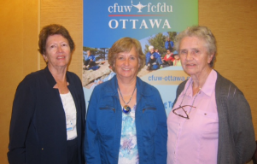
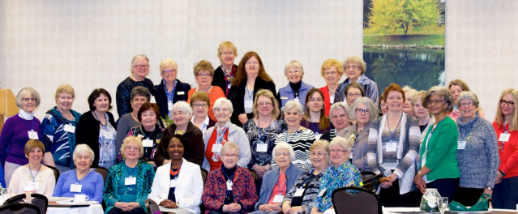
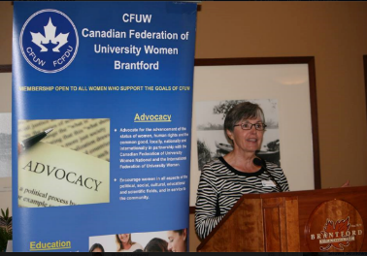
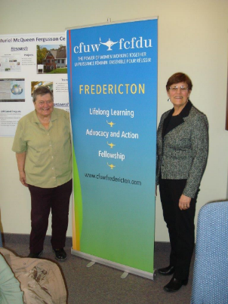
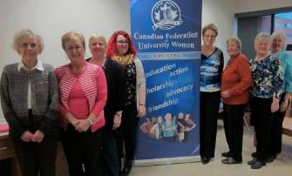
Annual Meetings – a chance to connect

Slide 6
Support for Clubs
Support and tools to promote, increase and maintain membership
Website development
Support for member recognition
Resources for Advocacy, for Presidents and Club Executives, for press releases and media
Access to excellent affiliate programs for discounts, rewards and safe travel options

Slide 7
Membership
Small Clubs Grants to attend the AGM
Teleconference Support for Membership Planning
Special Projects Award
New Members Award

Slide 8
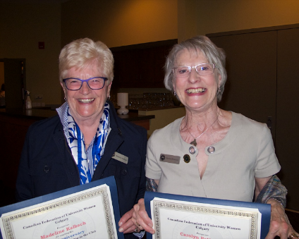
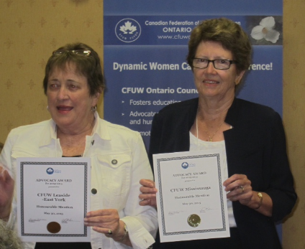
Recognition for Members and Clubs

Slide 9
Words from Small Clubs:
“… the conference … could influence the future of our club”
“I certainly took advantage of all opportunities to network with as many people as possible.”
“Attending a CFUW National Conference adds a whole new face to CFUW.”
“I hope that we, as a club, will tap into the resources that are available.”

Slide 10
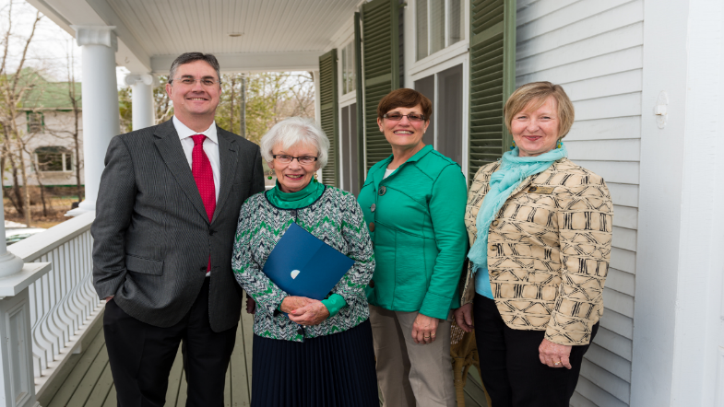
Fredericton – 70th Anniversary
Maureen O’Sullivan receives a 30+ membership certificate

Slide 11
Communication and Keeping Current
The Communicator, Week in Review, CFUW News and Updates, Press Agency
Three web sites
Two Facebook pages
Twitter
Newly designed promotion material

Slide 12
National Office
Research, advocate, make presentations, develop support materials, help with website development
Respond to membership needs for promotion and recognition.
Meet with and write letters to government representatives
Support a Board of Directors who contribute over 5,000 volunteer hours a year
Network with 25 other organizations

Slide 13
National Office
Write support news articles, letters to the editor, and press material for use by Clubs
Facilitate National campaigns e.g. Violence against Women, Missing and Murdered Aboriginal Women, Up for Debate
Provide Advocacy coaching
Assist with material supporting resolutions

Slide 14
Scholarships and Fellowships
Over 1 Million dollars awarded annually for scholarships and fellowships
Support for graduate programs through the Charitable Trust
A CFUW Fellowships and Awards program that is cost effective
Sponsorship of an international fellowship – Dr. Vibert A. Douglas award

Slide 15
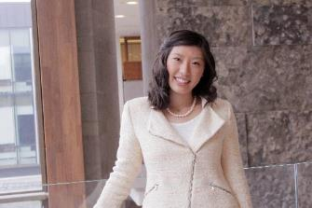
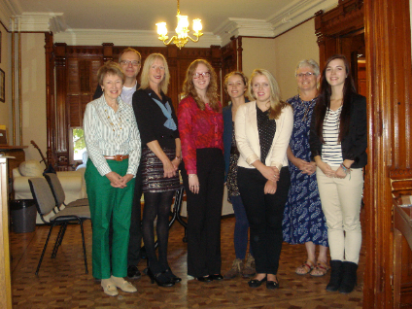
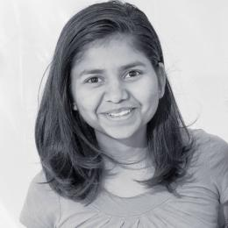
Iris Wu, Mississauga - dual major in Global Development and Honours Business Administration at Western and Ivey. Hopes to use the power of business to help developing countries.
Some of 2014 Scholarship Winners
Tushita Patel - CFUW Mississauga. Pursuing a double honours in Computer Science and Statistics at the University of Saskatchewan
CFUW Fredericton Scholarship winners

Slide 16
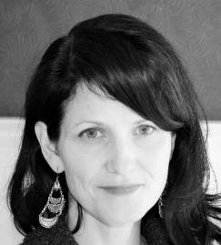
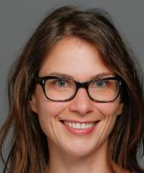
Fellowship Winners
CFUW Margaret Dale Philp Award
$3,500 funded by CFUW Kitchener-Waterloo
REBECCAH NELEMS
Ph.D. Sociology: Cultural, Social
and Political Thought (CSPT),
2013-2018, University of Victoria
CFUW Beverley Jackson Fellowship
$2,000 funded by UWC of North York HELENE LOVE
SJD University of Toronto

Slide 17
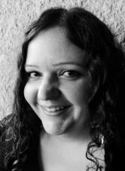
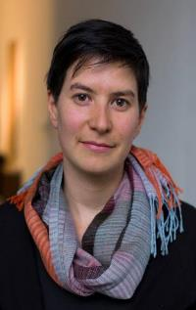
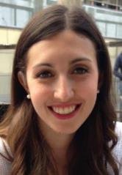
CFUW Bourse Georgette LeMoyne, $5,000
ANNE-SOPHIE RUEST-PAQUETTE
Joint Ph.D. Education and Social Service, 2009-2016 University of Ottawa and Laval University
CFUW Elizabeth Massey Award $5,000
sponsored by the Massey Family
VANESSA DION FLETCHER
M.F.A. Art Institute of Chicago
Ruth Binnie Fellowship, $6,000
ERIN LANDAU-CRANGLE
M.Sc. Medical Sciences:
Metabolism and Nutrition Stream,
2014-2016, McMaster

Slide 18
New this year …
CFUW Aboriginal Women’s Award
Funded by Education Council – Wolfville
Transfer of over $200,000. to honour Dr. Marion Elder Grant
Granted for studies in law, medicine, nurse practitioner or a Master’s in Aboriginal Studies

Slide 19
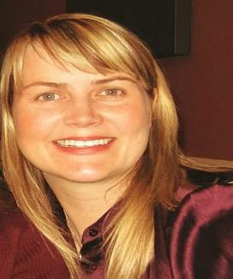
“
Canadian Home Economics Association (CHEA)
$6000
JANICE RIEGER
Ph.D. Human Ecology,
2013-2016
University of Alberta
… I am extremely grateful for this fellowship, not only for its financial award, but for the honor to represent Canadian women and their
scholarship.

Slide 20
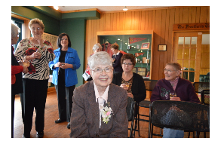
CFUW Fredericton
Dr. Nora Ni Chuiv, CFUW Fredericton member, at the reception celebrating the Dr. Nora Ni Chuiv Graduate Scholarship
Awarded to a UNB
Masters or PhD student
in Interdisciplinary
Studies

Slide 21
How Clubs Fundraise for Scholarships
Book Sales
Raffles/Tickets
Auctions
Luncheons and Dinners
Lectures
Art or Musical Shows
House Tours
and much more …

Slide 22
CFUW Wolfville
48th annual used book sale
Raising thousands of dollars for the club's philanthropic activities:
Scholarship aid for women
Donations to local and international educational charities and special projects.

Slide 23
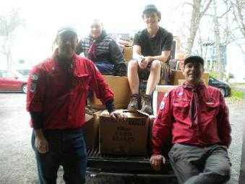
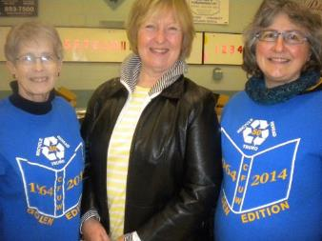
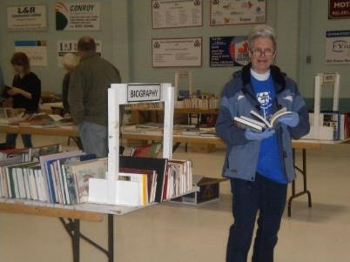
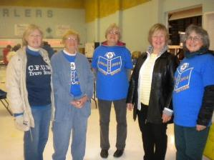
51st Annual Book Sale - Truro
With special help from the Knights of Columbus and Boy Scouts .
Two scholarships of $2200 each are awarded to mature students

Slide 24
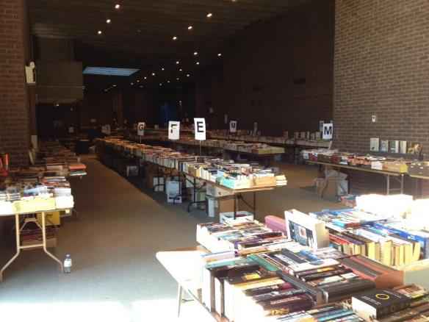
CFUW St. John’s Book Sale
May 2015 - $56,000 in three days!
Book Sale for Scholarships: Following a massive free community and media advertising campaign that even extended to 19 supermarkets putting book sale flyers in grocery orders, crowds flocked to the CFUW St. John’s used book sale to spend about $56 000 as they easily found treasures from amongst the 44 000 categorized books with fiction further alphabetized by author. Community partners, the Royal Newfoundland Constabulary (RNC), cadets helped move the books from the sorting centre to the sale venue, and later to the sales tables. Due to this massive effort by members, community partners, friends and family the Club’s scholarships and other community outreach projects are secure and an increase is being made in the Club’s budgeted contribution to the Charitable Trust.
Pictures 2, 3, 4, are relevant and Joyce has included the captions. (#2 shows one of many presentations of money this past year.)

Slide 25
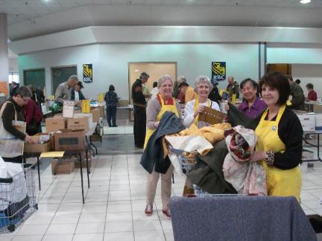
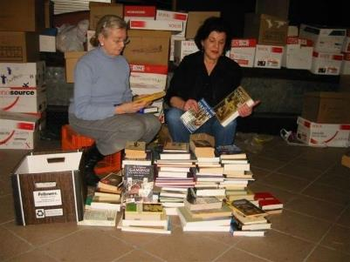
Book Sales - Fredericton
First held in 1964
Supports 11 scholarships
Named scholarships give special recognition to Club members who have contributed to the work of CFUW.

Slide 26
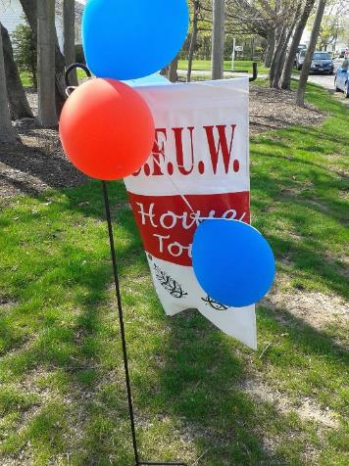
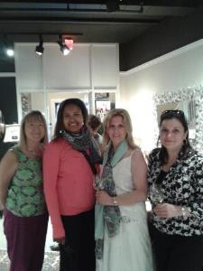
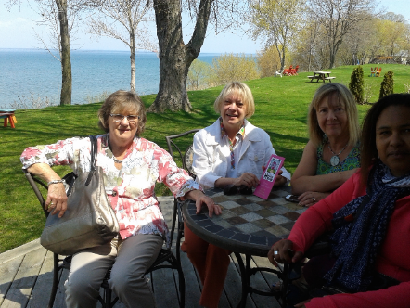
St. Catharines House Tour

Slide 27
CFUW Wolfville
Has been recognized by the Annapolis Valley Music Festival for their continued support by naming the new Elementary School Choir plaque in their honour.

Slide 28
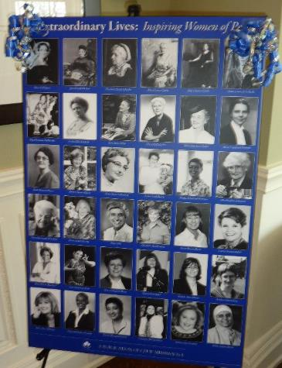
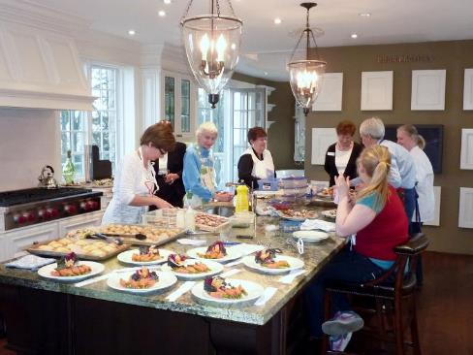
CFUW Mississauga – supporting the Charitable Trust $16,000 donated from sales of Extraordinary Lives: Inspiring Women of Peel

Slide 29
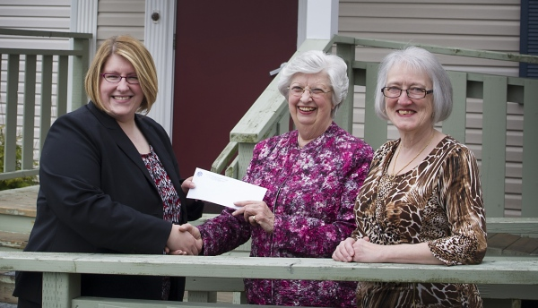
Presenting $20,000 for Scholarships to Memorial University

Slide 30
Lifelong Learning
220 book clubs
110 lecture series
75 issue groups
Plus
Local study groups
Public Forums
Interest groups

Slide 31
Lifelong Learning
Bridge Groups
Book Clubs
Speakers
Travel
International Affairs
Art Tours
Wine Tasting
Scotch Tasting
French Conversation
Writing Groups
Mah-jong
Investors
Genealogy
Travel
Gourmet Dining
Advocacy and Issues
Dancing
Hiking
And lots more …

Slide 32
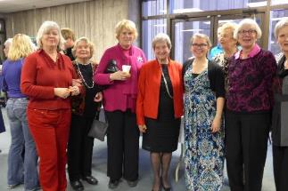
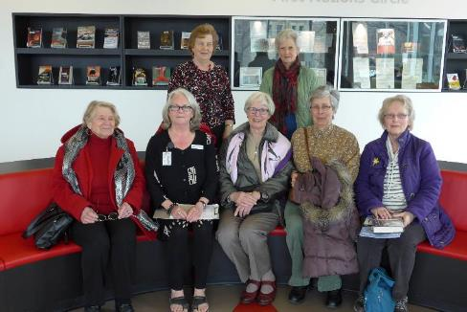
CFUW Dartmouth
Music Afternoon
Tour of New Library

Slide 33
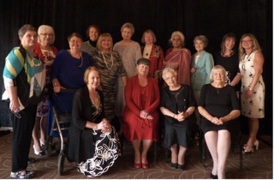
CFUW Regina 100 year celebration a ‘collective’ of past presidents

Slide 34
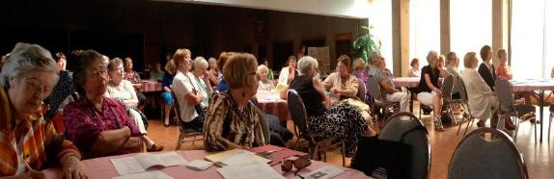
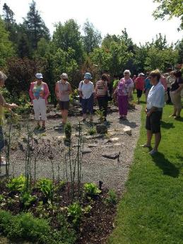
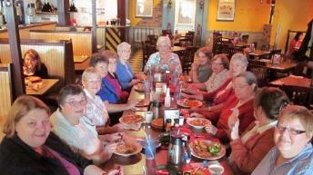
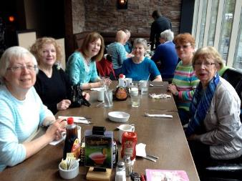
St. John’s
Open house and Membership Tea
Ladies Who Lunch
Interest Group
Alley Cats Bowling Awards Breakfast
Garden Outing

Slide 35
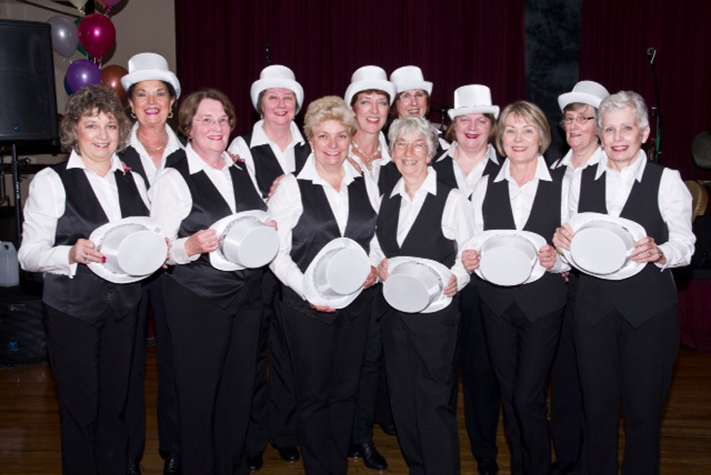
Only in Newfoundland!
Women on Tap

Slide 36
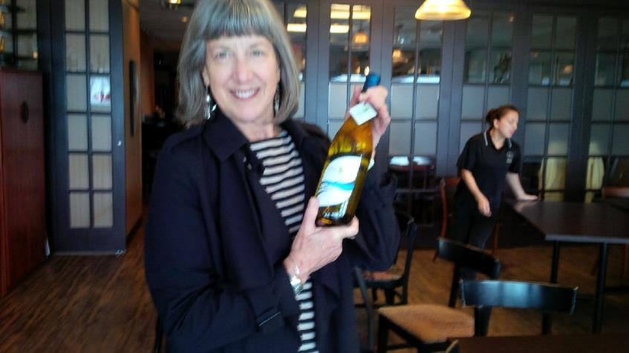
Kelowna/Vernon

Slide 37
Study Groups
Aboriginal Affairs
Child Care
Environment
Status of Women
STEM Education (science, technology, engineering and mathematics)
Universities
Afghan women
Connecting women across the country

Slide 38
Feedback
“I had joined a study group through CFUW…started researching the laws…astonished to discover we were far below standards”
  Susanna June Menzies,
  Manitoba Action Committee
  on the Status of Women

Slide 39
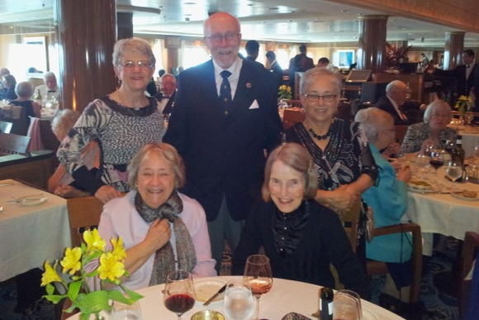
President’s Cruise – Literary Legends by Land and Sea, May 2014

Slide 40
Local Action
Soup sisters
Support for shelters
Shoe boxes
Reading in schools
Help for women re-entering the work force Creative art programs
Community Gardening

Slide 41
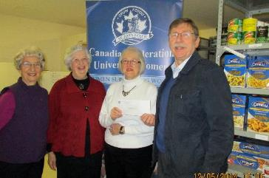
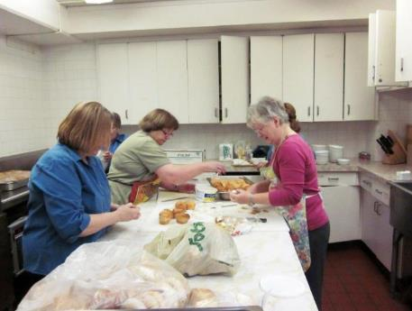
Presenting a cheque for $2500 to the MUN Foodbank, Nfld.
Preparing to serve lunch to residents in need – St. John’s

Slide 42
CFUW Moncton
• Attended Aboriginal “Sisters in Spirit Vigil” at NB Community College
• Donated to “Loretta Saunders Scholarship Fund” for Aboriginal women, in memory of a young, murdered Aboriginal woman

Slide 43
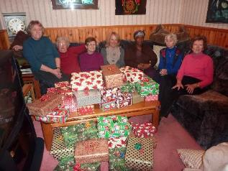
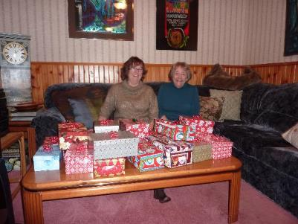
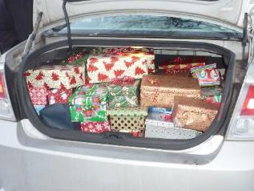
Shoeboxes for Shelters - Mississauga

Slide 44

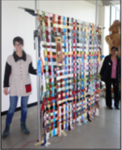
CFUW Abbotsford
Art Project with Women from the Warm Zone – a support service for street-entrenched women
A hanging made from keys

Slide 45
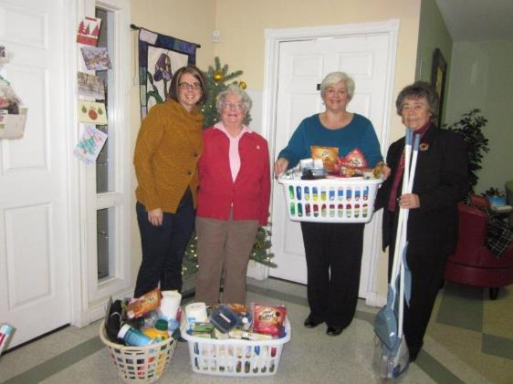
CFUW St. John’s members presenting "Fresh Start Baskets" to Iris Kirby House, a shelter for women and their children.

Slide 46
A Local Voice …
Perth and District – bylaw on idling
UWC Montreal Inc. – Financial Literacy
St. Thomas - Public Transportation Forum
Parksville-Qualicum - IWD All Candidates’ Meeting
Saskatoon – action on video surveillance of female prisoners

Slide 47
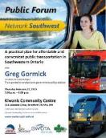
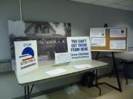






CFUW Stratford gettingthere.ca
Meetings with municipal government
Holding a public forum
Presentations to CFUW Ontario & National
Meetings with Metrolinx
Presentations to community groups
Meetings with other clubs: Kincardine
Working with United WayTransportation Task Force
Working with SWOTA: Southwest Ontario Transportation Alliance
Support of Network Southwest
Partnering visit of VIA Rail President to Stratford: Coordinating Round Table: June 2015
Television/radio interviews
Support St. Thomas, London forums
Meet with VIA Rail

Slide 48
AND …
Guelph – Early Learning and Childcare forum
Calgary North – Action on Murdered and Missing Indigenous Women and Girls
North Vancouver and West Vancouver – forum on hypersexualization of children

Slide 49
AND …
CFUW BURLINGTON

Slide 50
A Provincial Voice
Atlantic Regional Council – Dalhousie School of Dentistry Facebook harassment
Quebec Council – Aboriginal Women
Ontario Council
Poverty Reduction
Human Trafficking
Youth in Care
Early Learning & Child care

Slide 51
AND …
Alberta Council – Resolution on fracking
BC Council
  Year 3 - Child Poverty and Child Care Initiative
  Roundtable on Bountiful
  Prevention of Violence in Canada

Slide 52
A National Voice
Resolutions - Grassroots-derived public policy
Talking to governments - meetings, briefs, presentations, letters, and a demonstration or two
Partnerships with other like-minded organizations

Slide 53
Currently
National Initiative on Women and Violence
Budget analysis 2015
Election 2015
Up For Debate campaign
Early Learning and Childcare

Slide 54
Feedback
“We appreciate the support we have received in asking for a national inquiry for missing and murdered women”
  Institute of Aboriginal Women

Slide 55
Feedback
One National Leader said that material from CFUW is always treated seriously because it is “well written, thoroughly researched with thoughtful recommendations.”

Slide 56
An International Voice
International Women’s Day project
Women, Peace and Security
Nobel Women’s Initiative
Monitoring the work of the Department of Foreign Affairs, Trade and Development
  Maternal, Newborn and Child Health

Slide 57

The United Nations
Consultative Status with the UN
Economic and Social Council
(ECOSOC)
Member of UNESCO
Every year CFUW members are invited to join a delegation of up to 20 members to the UN Commission on the Status of Women.

Slide 58


Slide 59


Slide 60

UNCSW 2015
CFUW worked with 30+ organizations on joint shadow report on Canada’s implementation of the Beijing Platform for Action.

Slide 61

UNCSW 2015
CFUW members, Linda MacDonald and Jeanne Sarson, were
resource people
for three workshops
focused on the
CFUW resolution on
Non-State Torture.

Slide 62




UNCSW 2015

Slide 63
Direct Support for Projects Abroad …
Supporting Afghan Women
Supporting schools in Afghanistan, Malawi, Tanzania
Building toilets for girls in Ethiopia
Purchasing school supplies
Funding Bina Roy projects through IFUW (GWI)
Donating to Virginia Gildersleeves projects

Slide 64


CFUW Mississauga supporting education for girls in Tanzania

Slide 65

CFUW St. John’s- Outreach
Two, New Beginnings Baskets containing supplies for several weeks have continued to be filled by members’ donations each month for women leaving the women’s shelter, Iris Kirby House, to make a fresh start in life. CFUW member Elisabeth Mouland says "[the worker] who met me at the door, was ever so grateful for them and ecstatic about the bedding. She told me that they had never had such a busy April. Two of the women leaving tomorrow have nothing.”
#8 has a typo (should be hot lunches). BTW the Club cooked and served 65 people this week.
On Tuesday, June 2, 2015 12:30 AM, joyce Noseworthy <noseworthyje@nl.rogers.com> wrote:
St. John’s Club members preparing safe birth kits for distribution to women in Haiti and Nepal.

Slide 66
Graduate Women International (GWI) – formerly IFUW
CFUW is the largest affiliate of GWI
Access to IFUW resources, website, webinars, etc.
A chance to support women in developing countries
Opportunities to attend the Triennial Conference
An international network

Slide 67
Coming Soon …
Resource Website – power points, films, speakers and more
Webinars
Advocacy Training Manual
New CFUW website – interactive, informative and easy to use
Learning opportunities at the national level through national committees and study groups
Program ideas to support the Club level

Slide 68
And finally …
8000+ potential new friends in every province in the country
CFUW is one of the few self funded women’s organisations left in Canada
We are the Power of Women Working Together

